Slide 1
Toward a Cross-Domain Interoperability Framework
Arofan Gregory
Operative, Decadal Programme, CODATA
Chair, DDI-CDI Working Group, DDI Alliance
Simon Hodson
Executive Director, CODATA

Slide 2
Outline
The FAIR Challenge across Domains
“Market” Dynamics and Practical Implementation
What Makes a Standard “Cross-Domain”?
The Cross-Domain Interoperability Framework: Some Pieces of the Puzzle
Conclusions and Next Steps

Slide 3
The FAIR Challenge across Domains

Slide 4
The Cross-Domain FAIR Vision…
Users (both human and machine) can locate data of interest within or outside of their own domains/communities
They can determine and comply with the conditions of use
They can access and understand the data
They can integrate it with other data

Slide 5
Really?
To make this vision a reality, there are some hard requirements:
Exchange of large amounts of detailed information (data and metadata)
Interactions at many different technical levels
Ability to make the information exchanges at each level machine-actionable (to support increase in scale)
This demands that each “level” of interaction be supported by standards for information exchange across domains
This demands agreement on what the different levels of interaction are, and which standards will be used
This must be done, while recognizing that different domains have very different standards, data lifecycles, and workflows
And different semantics!
The challenges of adoption are massive!

Slide 6
The FAIR Digital Object Framework (FDOF)
The FDOF is now under development, but looks to become the basic set of protocols used for FAIR implementation
It has a number of components:
FAIR Implementation Profile (FIP): A description of how a given domain/community will support FAIR sharing, including significant FDPs
FAIR Data Point (FDP): A repository or distribution point for FAIR digital objects, supporting the FDOF protocols
FAIR Digital Object (FDO): A digital object described in RDF using the FDOF protocols, including pointers to relevant metadata and metadata schemas

Slide 7
Registry of Catalogues
FAIR Data Point
PID
(By Domain)
ACCESS
FIPs
DATA
(By Domain)
FAIR Digital
(Data) Object
The FDOF
provides the “types”
of objects
STRUCTURAL
METADATA
(META)METADATA
RESOURCES
SEMANTICS/
CLASSIFICATIONS
PROVENANCE/
PROCESS
METADATA

Slide 8
What’s Wrong with This Picture?
Question: Once you get the FDO you are after, how many standards will you need to understand to be able to actually use it?
Answer: Too many.
You cannot write generic applications or services for each user domain which understands every other domain which might have resources of interest
The FDOF works well as a protocol, but does not solve the “mid-level” problem of cross-domain interoperability
It is an “many-to-many” problem: each user domain must understand every provider domain’s standards!

Slide 9
The Cross-Domain Interoperability Framework Idea
A smaller number of agreed “generic” standards could be used to address this issue
For any given function, a small number of well-accepted standards could be used
Generic applications and services could support some or all of these, and could be used across domain implementations
Each domain would have targets for mapping to and from domain standards in each functional area
The “many-to-many” becomes a “many-to-one” problem: each domain maps against a small number of agreed standards

Slide 10
Scalability
The demand for data is huge
Data-hungry analysis approaches (e.g., machine learning)
Cross-domain research and policy problems (e.g., COVID, climate change)
Powerful enabling technologies (e.g., big data tools)
Expanding definition of “data” – new sources and types (e.g., social media, transactional and administrative registers)
Solutions must be scalable
Requires machine-actionability to the greatest possible extent
Requires generic applications and services across domains
Require more-complete, standard metadata for sharable resources

Slide 11
“Market” Dynamics and Practical Implementation

Slide 12
Considerations
Standards must function across domains
Standards must be as easy as possible to adopt
Flexibility (in terms of technologies)
Low barrier to entry
Standards should build on existing technology investments
Approach must be practical and based on real-world requirements

Slide 13
Domain vs. Generic Standards
The EOSC Interoperability Framework provides a good perspective on the different levels of standards:
Minimal Metadata (discovery metadata, Dublin Core, etc.)
Conceptual Metadata
Domain Metadata
Identifier Schemes
These names may not be clear out of context, but the diagrams from the EOSC IF documents help.
Virtually every domain has standards reflecting its terminology, concepts, processes and practices
Often include some generic information as well!
Not useful outside the domain…

Slide 14
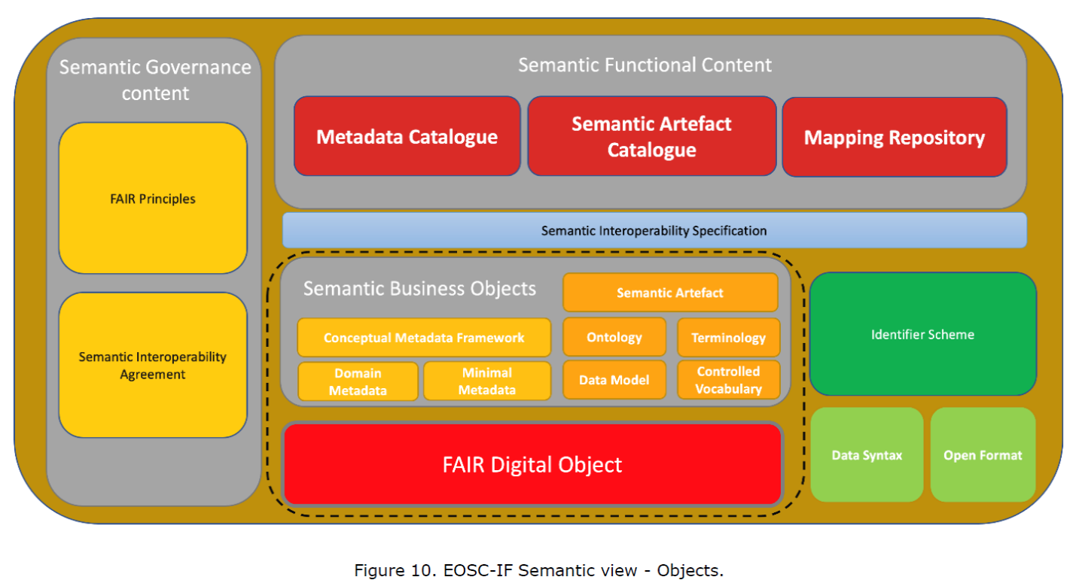
EOSC Interoperability Framework (1)
EOSC Interoperability Framework https://doi.org/10.2777/620649

Slide 15
EOSC Interoperability Framework (2)
EOSC Interoperability Framework https://doi.org/10.2777/620649

Slide 16
What Makes a Standard “Cross-Domain”?
There are only a few options:
Based on universally agreed semantics/functions (i.e., the Web)
Based on commonalities of structure/function (i.e., SKOS “concept”)
Based on configurations of common structures and functions to reflect domain specific information (e.g., meta-models)
Many modern standards mix domain-specific and domain-independent semantics!

Slide 17
“Adoptable” Standards?
Standards are adopted when the cost of their use is less than the benefit
The cost of un-FAIR data is huge
The demand for FAIR data is growing…
The simplicity of standards can make them more adoptable
But simplicity can be composed of hidden complexity – especially for complex things!
If software tools can produce standard expressions of the information they operate on, then even complex standards can be made easy for users
Existing practice around metadata will not meet the challenge
Cross-domain interoperability requires more, more-complete metadata!
“More of the same” is a formula for failure!
But we must leverage existing standard resources to the greatest extent possible! (Alignment)

Slide 18
Existing Technology Investments
RDF is generally seen as the enabling technology for FAIR by the academics
Many domains use different approaches
XML in the social sciences and official statistics (i.e., DDI, SDMX)
Binary formats in geo-spatial (i.e., NetCDF)
Etc.
Interoperability should be based on harmonized models, not on a single technology platform!

Slide 19
Practical Approaches
Reality-based methodology, driven by real-world use cases
“Outside in” approach – neither “top-down” nor “bottom-up”
FDOF at the top
Domain approaches at the bottom
Work on connecting the two!
Focus on the machine-actionable approaches which provide cross-cutting benefit across domains
Agreed set of targets for exposing data and metadata resources (cross-domain standards)
Domains “connect” from their own standards/technologies

Slide 20
An Emerging Solution - CDIF
There are many standards which are widely adopted because they are useful (e.g., Schema.org, DCAT, SKOS, etc.)
There is not yet a coordinated set of standards for meeting all needed functional requirements for FAIR
A coordinated set of cross-domain standards could be agreed, based on the recommendations of appropriate organizations (CODATA, RDA, GO FAIR, etc.)
Possible standards for use are now being discussed, but there is not yet any agreement
The form of recommendations is also yet to be determined

Slide 21
CDIF: Some Pieces of the Puzzle

Slide 22
Some Standards to Consider
Various standards are being used to support different aspects of FAIR data sharing
Some are established standards currently being adopted
Some are new standards or soon to be released
Some are still under development
This section will mention many of them
More anecdotal than comprehensive!
Only standards which are applicable across domains are considered
Requirements in terms of FAIR perspectives:
General exchange of “FAIR objects”
Findability
Accessibility
Interoperability
Reuse
The last two categories can be further broken down:
Structural metadata
Semantics and vocabularies
Context (provenance and fully-described observations of interest)
These areas impact both Interoperability and Reuse

Slide 23
Observations about FAIR Implementation
Focus at a detailed level for FAIR implementation has been very uneven
Lots of focus on discoverability and persistent identification (Findability)
Some discussion about data assessment, integration, and harmonization (Interoperability and Reuse)
Very little on Accessibility
Tools for evaluating FAIR data are not robust
Good progress has been made
Still seem to be based on assumptions which do not apply across all domains
Better evaluation tools for FAIR are still needed

Slide 24
General Exchange of FAIR Objects
The FAIR Digital Object Framework (FDOF) is seen as a generic way of interacting with digital objects of interest
Data
Metadata
Other information
The FDO Forum has formed a number of working groups to further detail what the FDOF will specifically address, to produce an agreed specification
For understanding the FAIR landscape, the FAIR Implementation Profile (FIP) is a new approach which is becoming a tool for characterizing and documenting FAIR approaches within communities of practice

Slide 25
Standards for Findability
This subject covers cataloguing of data, searching for data, and initial assessment of data for use
Two established specifications seem to dominate this space at the generic (supra-domain) level
Data Catalog Vocabulary (DCAT, including several different profiles e.g., DCAT-AP)
Schema.org
Both of these are based to some extent upon Dublin Core
Other metadata schemes to support discovery and cataloguing metadata exist at the domain and supra-domain level, but are not as widely accepted
DOIs are an important standard for persistent identification

Slide 26
Standards for Accessibility
Data (and also metadata) can be subject to different conditions of use in different domains, and this can be a challenge to manage, especially in a cross-domain scenario
For example, authentication and authorization infrastructure (AAI) is currently a major concern for research infrastructures and EOSC
Two W3C specifications are being developed to address these areas
Open Digital Rights Language (ODRL) – now version 2.2
Data Privacy Vocabulary (DPV) – still being developed (version 0.4)
Other models and standards may be useful
More exploration and consideration is needed

Slide 27
Standards for Interoperability and Reuse
The integration, harmonization, and effective reuse of data is an established need
It is traditionally labor-intensive – current approaches do not meet the demand
Automation based on machine-actionable metadata could potentially produce greater efficiencies
These aspects of FAIR are the most metadata-intensive
Often rely on the same or related sets of information
Involve complex models with different critical aspects
Require the highest levels of RDM maturity
Are very expensive in terms of effort to achieve
Are very domain-dependent
Three aspects are considered here:
Structural metadata
Semantics and vocabularies
Context and fully-described “observations of interest”

Slide 28
Structural Metadata
Many domain standards and proprietary formats contain this metadata – fewer standards for use across domain boundaries or technology environments
Data Documentation Initiative – Cross Domain Integration (DDI-CDI)
Soon to be released specification
Is designed to generically describe data sets and structures at a very granular level
Connects process descriptions (PROV-O, SDTL, VTL, proprietary) and descriptions of related data and metadata
Aligns with external standards (both generic and domain-specific)
Designed to provide a framework for effective use of semantic standards/vocabularies
Other more limited standards
W3C CSV on the Web
W3C Data Cube Vocabulary/SDMX
W3C Metadata Vocabulary for Tabular Data
Others (NGSI-LD? SOSA/SSN? Etc.)

Slide 29
DDI-CDI
Designed to provide some of the needed metadata
Description of different data structures
Description of the processes involved in producing data
Description of granular “datums” as they appear in different contexts (and are used to produce other datums)
Designed to be domain-independent
Structural/functional commonalities
Configurable to reflect domain semantics
Designed to be used with other standards
In combination with other domain-independent standards
As an expression of/link to domain-specific standards
To fill some of the gaps
Designed to be technology agnostic
Model-driven
“Implementation guides” provide details of community practice

Slide 30
Semantics
Many domain-specific ontologies and vocabularies
Some generic ones
Geography/time
Units of Measure (e.g, DRUM recommendations)
A few useful standards which are generic and widely used
OWL, RDF-Schema, etc.
Simple Knowledge Organization System (SKOS - and XKOS for statistical classifications)
One issue is attaching semantics to the structures of data
Different concepts can play different roles in different data sets (as a variable, as a category in a representation of a variable, as a unit type, etc.)
Vocabularies and traditional classifications/thesauri are important here
The “Ten Simple Rules” document is a good start down the path to making such resources FAIR
Semantic bridges/harmonizations exist
OBO Foundry work
Simple Standard for Sharing Ontology Mappings (SSSOM) - https://github.com/mapping-commons/SSSOM

Slide 31
Context and Fully Described Observations of Interest
Data shared across domain boundaries lacks much of the implicit knowledge which traditionally facilitates reuse
One major aspect of this is provenance and process
Standards such as the W3C PROV Ontology (PROV-O) are widely adopted
Some data-specific profiles also exist (e.g., PROV-ONE, etc.)
We have standards for describing processing functions (e.g., SDTL, VTL)
Clusters of variables are often important in understanding specific measurements or observations
Standards and models related to “observable properties” exist, notably from RDA’s I-ADOPT working group (also Observations & Measurement/OGC/SOSA/SSN work?)
Still relatively new

Slide 32
Managing FAIR Resources at the Business Level
There is an entire level of activity which goes beyond the immediate description of resources
What are resources created to do?
How are they used?
What are the costs/benefits?
This is one of the less-explored aspects of FAIR
There are some standards worth considering
Common European Research Information Format (CERIF)
UN/ECE Generic Activity Model for Statistical Organizations (GAMSO)

Slide 33
Conclusions and Next Steps

Slide 34
Summary
An agreed “cross-domain interoperability framework” is an emerging idea which seems to be gaining traction
Although not a simple solution, it is one which can be made adoptable
The key is cooperation and coordination through efforts like CODATA’s Decadal Programme, GOSC, RDA groups, GO FAIR, etc.

Slide 35
Ongoing Efforts
Decadal Programme
WorldFAIR
GOSC
EOSC Semantic Interoperability Task Force, research communities/infrastructures
Open science clouds (Africa, Canada, Australia, China, etc.)
Significant Research Infrastructures and calls to support cross-domain projects
RDA working groups (I-ADOPT, communities of practice, etc.)
GO FAIR (FIPs, FAIR-enabling resources)
Etc., etc., etc.

Slide 36
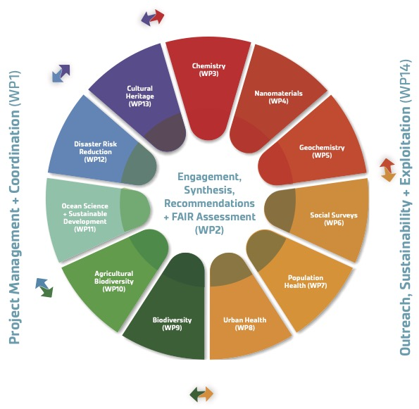
Common Aspects
Many initiatives are based on real-world use cases and practical approaches – a common methodology (in WorldFAIR and GOSC)
Many individuals participate in more then one group
Strong interest in and commitment to collaboration
Broad-based support around FAIR
Many ideas from many directions
Significant interest in finding practical solutions
How do we build on this?

Slide 37
Next Steps
Collaborate on WorldFAIR
Collaborate on GOSC
Feed back to CDIF and other initiatives based on our findings
Test out CDIF on use cases being considered
Explore connection to FDOF and domain standards
DP Coordination Group is being formed – “DP Scientific & Technical Advisory Group”

Slide 38
Questions?

