Slide 1
Data Description in DDI-CDI
Data Documentation Initiative –Cross Domain Integration

Slide 2
Think About During the Presentation
Are there data structures that you commonly use that we don’t seem to have covered?
What are they?
Do you see potential in DDI-CDI for needs that you currently don’t have met?
What have we missed?

Slide 3
Motivation for DDI-CDI
Making data actually usable together
Understanding meaning
Cross domain exchange
Harmonization
The same measurement represented differently
Comparable different measurements
Transformations among structures and platforms
Notes:
This presentation will focus on data description in DDI-CDI, and in particular some of the new features in the model. One of the motivations of the CDI project was to broaden the focus of DDI beyond the somewhat survey orientation of DDI Codebook and lifecycle.
CDI has features that makes it possible to track data across different platforms and structures.

Slide 4
Our example
Imagine that a program (Python?) collects Covid related information at building doors:
Blood Pressure( Systolic, diastolic)
Position for BP
weight
temperature
pctO2
pulse
beenToFloridaEtc?
exposed?
Position (prone, sitting, standing)
beenToFloridaEtc ,Exposed (yes, no)
Notes:
In this presentation we’ll use a set of sample data that might be collected in the screenings that are common now for the Covid19 pandemic. These include biometric and survey type data. This photo shows some of the instruments that might be used to collect the data in a home setting.

Slide 5
Describing Data
A broad topic
Considerations for the metadata
Purpose
Audience
Level
Study, Dataset, Variables, File, Record, Datum
Conceptual, representational, physical
Machine actionability
Notes:
The notion of describing data encompasses a broad range of information types. What is important in the description depends on the purpose of the description, the intended audience and the level of description needed. Data can be described at the study level, like might be found in the methods section of a paper, at the dataset or variable level, like an archive might do to support discovery, or at the file or record level for data exchange.
The descriptions can be at a conceptual level, or more concrete levels like details of how the data are represented.
DDI CDI adds a finer level of description than previous releases by allowing description at the datum or cell level.

Slide 6
Documentation Purposes
Meaning
Concepts, value domain
Provenance
Process, chain of custody
Administration
Quality assurance, contractual requirements, HR issues
Discovery
E.g. Dublin Core, Schema.org
Physical Representation
Layout, encoding, format
Notes:
Data may be described to fulfill an number of purposes. Many of these are interrelated. It might be important to describe the meaning of variables, for example, by describing related concepts and their intended value domains. It might be important to describe the provenance of the data. Knowing the process that generated the data would also inform the meaning of the data. An administrator might want information needed for assuring data quality, or for reporting purposes. An archive might need specific information to enhance discovery of data for its users. Users of the data would need specifics about the layout and representation of the data.

Slide 7
Audience
Data creator
Archive and Data Center
Administrator
Funder
Eventual user
Notes:
As just mentioned, the type of metadata needed will depend on the audience for the data or the metadata. Data creators may be interested in metadata that would allow them to collect new data compatible with existing data and to use metadata driven processes. Data creators are also consumers of data collected by their past selves. They need to record information that allows the data to be reused by themselves and others. As mentioned, archives, administrators and funders all may have specific needs.

Slide 8
Levels
The Entity
Study
Dataset
Record
Variables
Datum
The Information
Conceptual
Representational
Instance
Physical Details
Notes:
Data descriptive information might also be categorize as existing at multiple levels Different information is needed at the study, dataset, record and variables level. Different information is needed at the broad conceptual level about a variable than at the level of actually making measurements or using collected data.

Slide 9
Levels
The Entity
Study
Dataset
Record (traditional row)
Variables (traditional column)
Datum
The Information
Conceptual
Representational
Instance
Physical Details
Notes:
DDI CDI allows for different information to be recorded for each cell in a table. As we’ll see this also means that all of the most specific information about the representation of values needs to be represented separately from the level of a whole column in a traditional rectangular unit record table. DDI-CDI can separate recording information about structure (a column) from recording information about meaning (a variable)

Slide 10
DDI-CDI enhancements
Variables
Variable cascade
Roles: ID, Measure, Attribute
Substantive and Sentinel values
Physical data
Text representations with hooks for other datatypes, qualitative data
Datum
Linking InstanceVariable, InstanceValue, ConceptualValue
Keys and Structure
Nuanced contributor role
Collections
“Annotation” (bad name)? – a package of mostly discovery related information applied in many places. The structure of this may also be modeled differently in the future.
Notes:
There are an number of enhancements over previous versions of DDI that DDI-CDI offers. Here is a list of some of them. The following slides will discuss these in more detail.

Slide 11
Variable Cascade – Conceptual Variable
Variable descriptions at a high level. Early in designing data collection, broad searches. Broadly reusable.
Notes:
The ConceptualVariable holds information at a very general level.

Slide 12
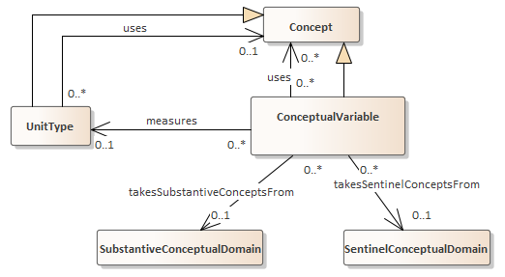
ConceptualVariable
We want to collect these measures on people:
Blood Pressure( Systolic, diastolic)
Position for BP
weight
temperature
pctO2
pulse
beenToFloridaEtc?
exposed?
Notes:
In addition to a text description, the model can describe Concepts associated with the ConceptualVariable. It can also describe what units (e.g. a measure of the weight of people not rocks). It can also describe substantive and sentinel conceptual domains. Weight could be measures as a number. The substantive categories for exposed could be yes and no, without any maybe. The sentinel categories could be “don’t know” and “unanswered”. No codes for those categories are specified at this level. Those are specified at the RepresentedVariable level. This allows tying together any RepresentedVariables that use different codes for the same categories. (e.g. 1, or 2, or y for yes)

Slide 13
Variable Cascade - RepresentedVariable
More specificity about value domain, units of measurement. Still reusable.
Notes:
RepresentedVariables add information about the universe on which the variable is measured (e.g. people in the US) value domains:
The 1, 2, or Y for yes from the previous slide, or the kind of number for weight.

Slide 14
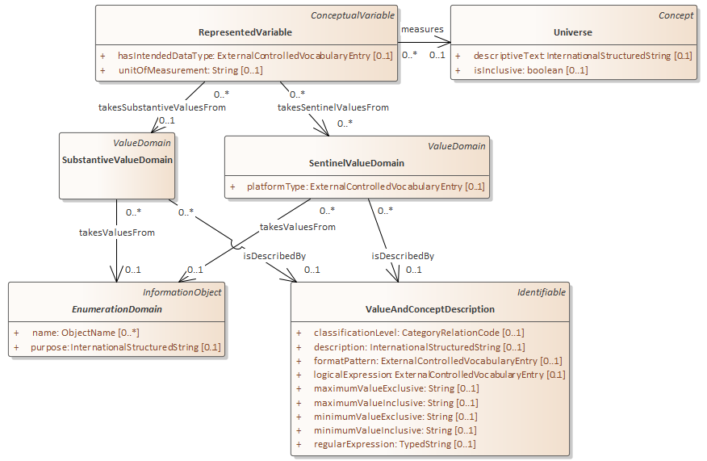
RepresentedVariable
People in the U.S.
Blood Pressure( Systolic, diastolic)
Numeric,
Float
Min 0/0
Max 400/400
(mmHg)
Position for BP
Code
1=Prone
2=Sitting
3=Standing
Supports the ISO/IEC 11404 construct of
substantive and sentinel value domains
Notes:
Here are possible value domains from our example. Systolic and Diastolic could be described as being represented by a floating point number with a minimum of 0 and a maximum or 400 (hopefully either not ever collected),
Codes of 1,2, and 3 could be specified for the position variable.
Values that fall outside of the set of values of interest (the substantive values) are sentinel values. Missing values are an example of sentinel values. Other examples might be categorical range codes for suppressed data, which carry some substantive information but cannot be used in numeric calculations.

Slide 15
Variable Cascade - InstanceVariable
Describing collected data. Physical datatype and platform. Invariant role of the variable (e.g. a weight)
Notes:
InstanceVariables are for collected data.

Slide 16
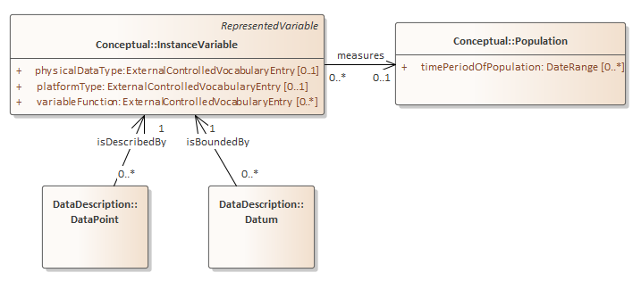
InstanceVariable
Blood Pressure( Systolic, diastolic)
Numeric, millimeters of mercury (mmHg)
Float, Python,
Position for BP
Code
1=Prone
2=Sitting
3=Standing
Note: InstanceVariable inherits relationship to value domains that allows anything from higher levels of the cascade to be described here without creating a RepresentedVariable.
Notes:
The InstanceVariable can specify the specific Population measured (e.g. people at Blake Hall in August 2014). It can also specify a specific platform. This is useful when sentinel values need to change if, for example moving data from SAS which allows multiple different missing values (e.g. .A to .Z) to R which only allows one value (NA).
It can also specify a specific physical datatype ( e.g. a 64 bit float)
Note the links from DataPoint and Datum to InstanceVariable. This allows each cell in a structure to indicate it’s own InstanceVariable. We’ll see the utility of this in discussing tall and key-value structures.

Slide 17
Instance Variable vs Physical Representation
DDI-CDI adds a description of physical values in a physical record. This allows the same Instance Variable to be represented in, for instance, different file layouts (e.g. commas vs periods as thousands separators)
Notes:
To this cascade, DDI-CDI adds the ability to do detailed description of the physical representation of values as they appear in files. We tried to make this compatible with the W3C tabular data on the web standards.

Slide 18
Variable Cascade – ValueMapping
Notes:
The same captured information can be written to physical files with differing representations (e.g. strings) that do net really change the information content. The Value Mapping allows for an extension of the description of a physical representation that goes beyond the InstanceVariable. The ValueMapping is intended to be compatible with the W3C tabular data on the web standard.

Slide 19
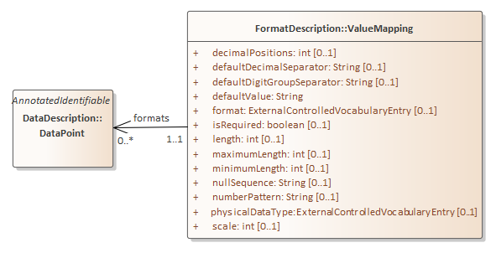
Variable Cascade – ValueMapping Example
For Europe
entry datetime systolic diastolic position weight temp pctO2 pulse away exposed
101 2020-07-14T13:54 114 70 2 83.914,6 36,44 98 70 n n
132 2020-07-14T14:03 125 86 3 68.038,9 37,50 85 92 y n
For US
entry datetime systolic diastolic position weight temp pctO2 pulse away exposed
101 2020-07-14T13:54 114 70 2 83,914.6 36.44 98 70 n n
132 2020-07-14T14:03 125 86 3 68,038.9 37.50 85 92 y n
Notes:
Here two files use different digit separators and decimal indicators, but are otherwise identical. They both can share the same InstanceVariable for weight (grams to the nearest 10th) and temp (degrees C to the nearest hundredth).

Slide 20
Structures
DDI-CDI currently can describe four different data structures
Wide – as with unit records
Tall - as with event or stream data
Key value – as in a key-value store
Dimensional - as with aggregate data
Notes:
For now, DDI-CDI can describe four fundamental structure types. Wide, Tall, Key-value and dimensional. Examples follow.

Slide 21
Wide Example
As a spreadsheet table
entry | datetime | systolic | diastolic | position | weight | temp | pctO2 | pulse | away | exposed
101 | 2020-07-14T13:54 | 114 | 70 | 2 | 83914.6 | 36.44 | 98 | 70 | n | n
132 | 2020-07-14T14:03 | 125 | 86 | 3 | 68038.9 | 37.5 | 85 | 92 | y | n
As tab delimited text lines
entry datetime systolic diastolic position weight temp pctO2 pulse away exposed
101 2020-07-14T13:54 114 70 2 83,914.6 36.44 98 70 n n
132 2020-07-14T14:03 125 86 3 68,038.9 37.50 85 92 y n
Notes:
Here are two rows of our example data in a wide structure. At top the data are displayed as in a spreadsheet. Below they are displayed as tab delimited text. Each row represents one observed unit (a person) and each column contains values for one variable, for example the person’s temperature in degrees Celsius .

Slide 22
Tall Example
Entry | DateTime | Measure | Position | Value
101 | 2020-07-14T13:54 | systolic | 2 | 114
101 | 2020-07-14T13:54 | diastolic | 2 | 70
101 | 2020-07-14T13:54 | weight | 2 | 83914.60
101 | 2020-07-14T13:54 | temp | 2 | 36.44
101 | 2020-07-14T13:54 | pctO2 | 2 | 98
101 | 2020-07-14T13:54 | pulse | 2 | 70
101 | 2020-07-14T13:54 | away | 2 | n
101 | 2020-07-14T13:54 | exposed | 2 | n
132 | 2020-07-14T14:03 | systolic | 3 | 125
132 | 2020-07-14T14:03 | diastolic | 3 | 86
132 | 2020-07-14T14:03 | weight | 3 | 68038.90
132 | 2020-07-14T14:03 | temp | 3 | 37.5
132 | 2020-07-14T14:03 | pctO2 | 3 | 85
132 | 2020-07-14T14:03 | pulse | 3 | 92
132 | 2020-07-14T14:03 | away | 3 | y
132 | 2020-07-14T14:03 | exposed | 3 | n
Notes:
Here are the same data in a tall structure, The columns Entry and DateTime are identifiers and Position is an attribute. These are repeated from their respective row in the wide structure. The column labeled Value has the other values from both wide rows..

Slide 23
Key-Value Example
Key | Value
101_2020-07-14T13:54_2_systolic | 114
101_2020-07-14T13:54_2_diastolic | 70
101_2020-07-14T13:54_2_weight | 83914.60
101_2020-07-14T13:54_2_temp | 36.44
101_2020-07-14T13:54_2_pctO2 | 98
101_2020-07-14T13:54_2_pulse | 70
101_2020-07-14T13:54_2_away | n
101_2020-07-14T13:54_2_exposed | n
132_2020-07-14T14:03_3_systolic | 125
132_2020-07-14T14:03_3_diastolic | 86
132_2020-07-14T14:03_3_weight | 68038.90
132_2020-07-14T14:03_3_temp | 37.5
132_2020-07-14T14:03_3_pctO2 | 85
132_2020-07-14T14:03_3_pulse | 92
132_2020-07-14T14:03_3_away | y
132_2020-07-14T14:03_3_exposed | n
Notes:
Here Entry, DateTime, Position, and Measure have been combined to form a single key with the components separated by underscores.

Slide 24
Dimensional Example
mean temp | exposed
away | Y | N
Y | 38.3 | 37.2
N | 37.8 | 36.6
away | exposed | meanTemp
Y | Y | 38.3
Y | N | 37.2
N | Y | 37.8
N | N | 36.6
Dimensions are defined by away and exposed. For each combination of dimension values there is a summary value – the mean of temp.
The dimensional data are shown here in two layouts, a cross tabulation and a tall structure.
Questions:
Have you traveled outside of the county in the last two weeks? (circle one)
Yes No
Have you had contact with anyone diagnosed with Covid-19? (circle one)?
Yes No
Notes:
In this example there are summary data (the mean of temp) in each cell. The two dimensions each have two levels Yes and No, coded here as Y and N. These come from the questions seen at the bottom of the slide.

Slide 25
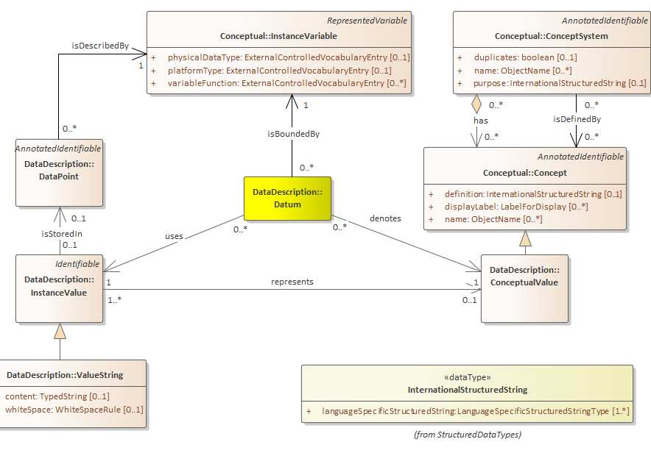
The Datum Approach
Notes:
All of the preceding structures are built up as sets of DataPoints.
It might be worth describing this one model diagram in detail, The Datum ties together the InstanceVariable, the InstanceValue and the ConceptualValue. Contained in a DataPoint, the InstanceValue is the physical representation of the person’s systolic BP at that point in time. In this case it is a string. The InstanceVariable carries the metadata described earlier.
There could be many InstanceValues representing the same ConceptualValue.

Slide 26
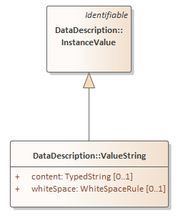
InstanceValue
For now, only a string extends InstanceValue.
It’s modeled this way to allow for other kinds of values, including binary types like, 64 or 128 bit float, images, audio clips and more.
This could also include other datatypes like lists and dictionaries (hash tables).
This will enable extension to qualitative data and data like JSON.
For Europe
entry datetime systolic diastolic position weight temp pctO2 pulse away exposed
101 2020-07-14T13:54 114 70 2 83.914,6 36,44 98 70 n n
132 2020-07-14T14:03 125 86 3 68.038,9 37,50 85 92 y n
For US
entry datetime systolic diastolic position weight temp pctO2 pulse away exposed
101 2020-07-14T13:54 114 70 2 83,914.6 36.44 98 70 n n
132 2020-07-14T14:03 125 86 3 68,038.9 37.50 85 92 y n
Notes:
Currently the InstanceValue is only extended as a string. Almost certainly, there will be other types of InstanceValues – for example IEEE 754 float would be a good candidate, DDI-CDI could be extended to cover qualitative data like images and audio clips.,

Slide 27
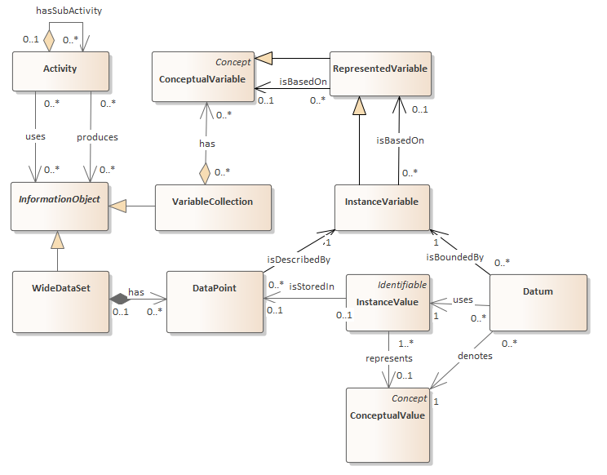
Datum
Notes:
The DataPoint may reside in some more complex structure, Here that would be a WideDataset produced by some Activity.

Slide 28
The Value Column in a Tall Structure
The value column here is not a traditional variable. It’s entries do not have a common concept or value domain.
Entry | DateTime | Measure | Position | Value
101 | 2020-07-14T13:54 | systolic | 2 | 114
101 | 2020-07-14T13:54 | diastolic | 2 | 70
101 | 2020-07-14T13:54 | weight | 2 | 83914.60
101 | 2020-07-14T13:54 | temp | 2 | 36.44
101 | 2020-07-14T13:54 | pctO2 | 2 | 98
101 | 2020-07-14T13:54 | pulse | 2 | 70
101 | 2020-07-14T13:54 | away | 2 | n
101 | 2020-07-14T13:54 | exposed | 2 | n
132 | 2020-07-14T14:03 | systolic | 3 | 125
132 | 2020-07-14T14:03 | diastolic | 3 | 86
132 | 2020-07-14T14:03 | weight | 3 | 68038.90
132 | 2020-07-14T14:03 | temp | 3 | 37.5
132 | 2020-07-14T14:03 | pctO2 | 3 | 85
132 | 2020-07-14T14:03 | pulse | 3 | 92
132 | 2020-07-14T14:03 | away | 3 | y
132 | 2020-07-14T14:03 | exposed | 3 | n
Notes:
One of the motivating factors in going with the datum approach is posed by describing the column labeled Value here. Each cell in the column might have a different associated bundle of information that we have in the Instance variable – it’s concept, value domain, and unit of measurement, even perhaps its unit type. A stream might contain values from an air sensor, a water sensor and more.

Slide 29
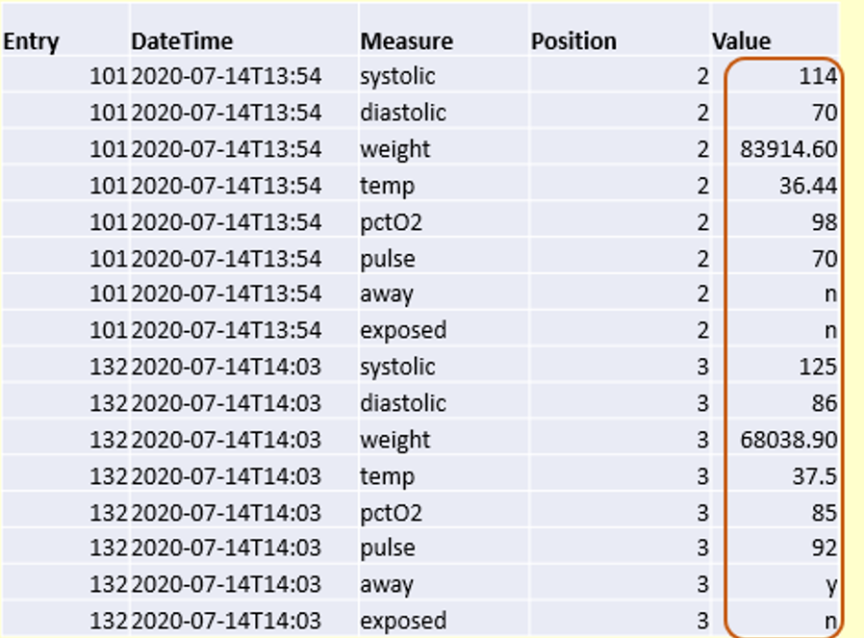
DataPoints and Dataset Structures
DDI-C and DDI-L
Record orientation (Dataset is a collection of records)
No distinction between a column and a variable (everything in a column is homogeneous)
DDI-CDI
DataPoint Orientation
Each DataPoint could be tied to a different variable.
Allows a better description of tall structures (streams, event data)
Notes:
Earlier versions of DDI could not easily describe a column like the Value column in the previous example. DDI Codebook and Lifecycle described tables as a set of records and records as a sequence of variables. They would have had to describe the table as a set of heterogenous records. It would be hard to track the flow of data from transformations between wide and tall. These transformations are common operations in many statistical and data management packages.
By building up structures from DataPoints (cells) DDI-CDI allows for following a DataPOint as it moves among different structures.

Slide 30
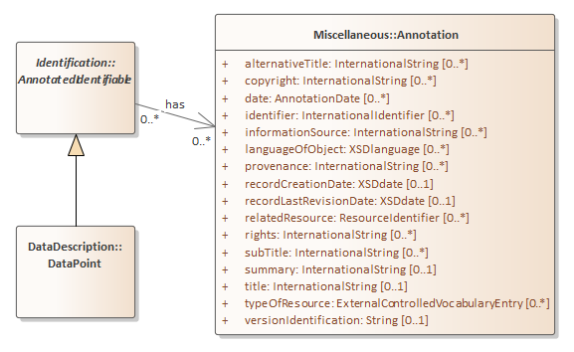
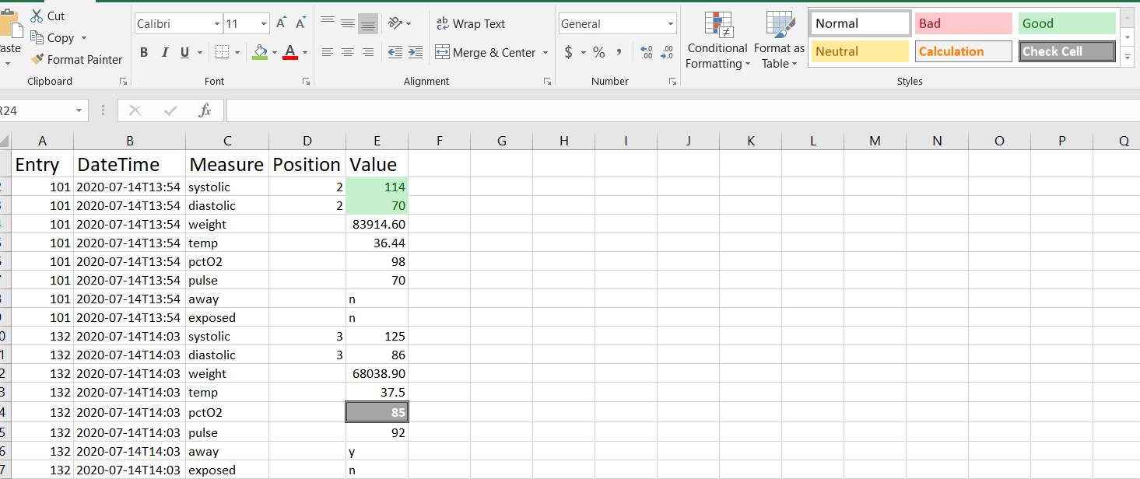
Annotating a DataPoint
Notes:
It’s not unknown, anymore to have metadata at the cell(DataPoint) level. Excel, for example has built-in styles for cells allowing them to be labeled with standard or custom styles.
DDI-CDI allows for a package of metadata to be attached to an individual DataPoint. There have been suggestions that this package (the Annotation class) be structured differently but the ability to attach that set of information at the DataPoint level should not change.

Slide 31
Tracking across structures
Previous versions of DDI would have difficulty in documenting these three representations of the weight of entry 101 at 2020-07-14T13:54 as representing the same thing.
DDI-CDI can tie all three to the same ConceptualValue, and through the use of keys map the transformations between the long structure at right and the wide structures below.
Entry | DateTime | Position | Measure | Value
101 | 2020-07-14T13:54 | 2 | systolic | 114
101 | 2020-07-14T13:54 | 2 | diastolic | 70
101 | 2020-07-14T13:54 | 2 | weight | 83914.60
101 | 2020-07-14T13:54 | 2 | temp | 36.44
101 | 2020-07-14T13:54 | 2 | pctO2 | 98
101 | 2020-07-14T13:54 | 2 | pulse | 70
101 | 2020-07-14T13:54 | 2 | away | n
101 | 2020-07-14T13:54 | 2 | exposed | n
132 | 2020-07-14T14:03 | 3 | systolic | 125
132 | 2020-07-14T14:03 | 3 | diastolic | 86
132 | 2020-07-14T14:03 | 3 | weight | 68038.90
132 | 2020-07-14T14:03 | 3 | temp | 37.5
132 | 2020-07-14T14:03 | 3 | pctO2 | 85
132 | 2020-07-14T14:03 | 3 | pulse | 92
132 | 2020-07-14T14:03 | 3 | away | y
132 | 2020-07-14T14:03 | 3 | exposed | n
For Europe
entry datetime systolic diastolic position weight temp pctO2 pulse away exposed
101 2020-07-14T13:54 114 70 2 83.914,6 36,44 98 70 n n
132 2020-07-14T14:03 125 86 3 68.038,9 37,50 85 92 y n
For US
entry datetime systolic diastolic position weight temp pctO2 pulse away exposed
101 2020-07-14T13:54 114 70 2 83,914.6 36.44 98 70 n n
132 2020-07-14T14:03 125 86 3 68,038.9 37.50 85 92 y n
Notes:
DDI-CDI allows for identifying DataPoints through the use of keys.

Slide 32
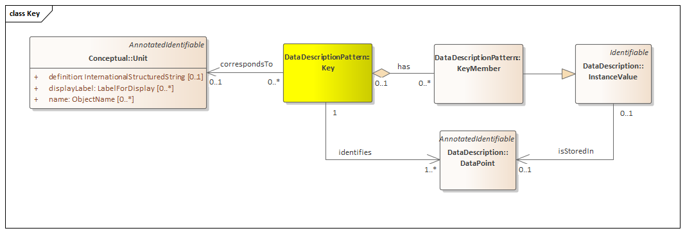
Keys
Notes:
DDI-CDI uses keys to place DataPoints in a structure

Slide 33
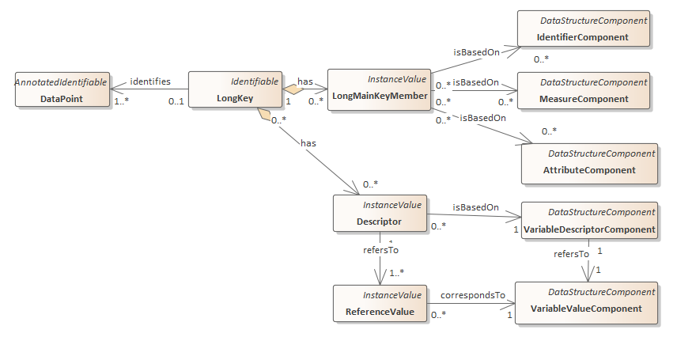
Identifiers, Measures, and Attributes
VariableDescriptorComponent
AttributeComponent
Identifiers
Entry | DateTime | Position | Measure | Value
101 | 2020-07-14T13:54 | 2 | systolic | 114
101 | 2020-07-14T13:54 | 2 | diastolic | 70
101 | 2020-07-14T13:54 | 2 | weight | 83914.60
101 | 2020-07-14T13:54 | 2 | temp | 36.44
101 | 2020-07-14T13:54 | 2 | pctO2 | 98
101 | 2020-07-14T13:54 | 2 | pulse | 70
101 | 2020-07-14T13:54 | 2 | away | n
101 | 2020-07-14T13:54 | 2 | exposed | n
132 | 2020-07-14T14:03 | 3 | systolic | 125
132 | 2020-07-14T14:03 | 3 | diastolic | 86
132 | 2020-07-14T14:03 | 3 | weight | 68038.90
132 | 2020-07-14T14:03 | 3 | temp | 37.5
132 | 2020-07-14T14:03 | 3 | pctO2 | 85
132 | 2020-07-14T14:03 | 3 | pulse | 92
132 | 2020-07-14T14:03 | 3 | away | y
132 | 2020-07-14T14:03 | 3 | exposed | n
VariableValueComponent
Notes:
DDI-CDI builds up compound keys from components. For Long structures there are identifier, measure and attribute components. Here Position is intended as an attribute of the blood pressure measurement. More on that in the next slide. A long structure has a column that is problematic for describing this as a traditional record. The Value column does not have a single concept or datatype., instead there is another column that has a code that indicates what the measure is. This is a common type of structure for event or stream data. Here, he value column is associated with a VariableValueComponent and the Measure column is associated with the VariableDescriptorComponent.

Slide 34
Key-Value Structures
Key | Value
101_2020-07-14T13:54_2_systolic | 114
101_2020-07-14T13:54_2_diastolic | 70
101_2020-07-14T13:54_2_weight | 83914.60
101_2020-07-14T13:54_2_temp | 36.44
101_2020-07-14T13:54_2_pctO2 | 98
101_2020-07-14T13:54_2_pulse | 70
101_2020-07-14T13:54_2_away | n
101_2020-07-14T13:54_2_exposed | n
132_2020-07-14T14:03_3_systolic | 125
132_2020-07-14T14:03_3_diastolic | 86
132_2020-07-14T14:03_3_weight | 68038.90
132_2020-07-14T14:03_3_temp | 37.5
132_2020-07-14T14:03_3_pctO2 | 85
132_2020-07-14T14:03_3_pulse | 92
132_2020-07-14T14:03_3_away | y
132_2020-07-14T14:03_3_exposed | n
Notes:
This use of keys also makes it natural for DDI-CDI to describe key-value structures in a way that can map to the other types of structures.

Slide 35
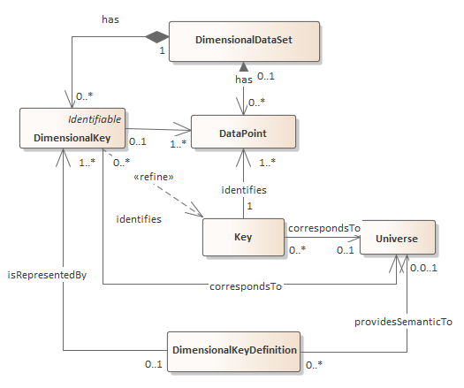
Dimensional data
mean temp | exposed
away | Y | N
Y | 38.3 | 37.2
N | 37.8 | 36.6
away | exposed | meanTemp
Y | Y | 38.3
Y | N | 37.2
N | Y | 37.8
N | N | 36.6
Notes:
Like with the other structures, a dimensional structure places DataPoints into the structure through the use of keys. The additional components of the keys needed for that is too complex to go into here, but it is basically an extension of the components for the wide and long structures.
As such this approach should help track the microdata that contribute to the aggregate values in each cell of a dimensional structure.

Slide 36
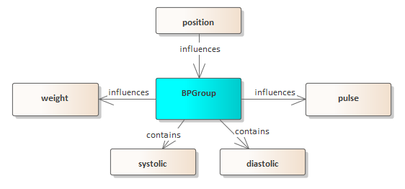
Paradata as Attributes in DDI-CDI
Systolic, diastolic and position could be defined as a variable collection with a structure indicating that
Entry | DateTime | Measure | Position | Value
101 | 2020-07-14T13:54 | systolic | 2 | 114
101 | 2020-07-14T13:54 | diastolic | 2 | 70
101 | 2020-07-14T13:54 | weight |  | 83914.60
101 | 2020-07-14T13:54 | temp |  | 36.44
101 | 2020-07-14T13:54 | pctO2 |  | 98
101 | 2020-07-14T13:54 | pulse |  | 70
101 | 2020-07-14T13:54 | away |  | n
101 | 2020-07-14T13:54 | exposed |  | n
132 | 2020-07-14T14:03 | systolic | 3 | 125
132 | 2020-07-14T14:03 | diastolic | 3 | 86
132 | 2020-07-14T14:03 | weight |  | 68038.90
132 | 2020-07-14T14:03 | temp |  | 37.5
132 | 2020-07-14T14:03 | pctO2 |  | 85
132 | 2020-07-14T14:03 | pulse |  | 92
132 | 2020-07-14T14:03 | away |  | y
132 | 2020-07-14T14:03 | exposed |  | n
For Europe
entry datetime systolic diastolic position weight temp pctO2 pulse away exposed
101 2020-07-14T13:54 114 70 2 83.914,6 36,44 98 70 n n
132 2020-07-14T14:03 125 86 3 68.038,9 37,50 85 92 y n
For US
entry datetime systolic diastolic position weight temp pctO2 pulse away exposed
101 2020-07-14T13:54 114 70 2 83,914.6 36.44 98 70 n n
132 2020-07-14T14:03 125 86 3 68,038.9 37.50 85 92 y n
Notes:
Here Position is intended as an attribute of the blood pressure measurement. In the tall structure that can be made clear by only having it in the relevant rows. In the wide structure that is not possible.
The VariableCollection shown earlier could be useful for the wide structure to indicate that position is an attribute of the blood pressure measures.

Slide 37
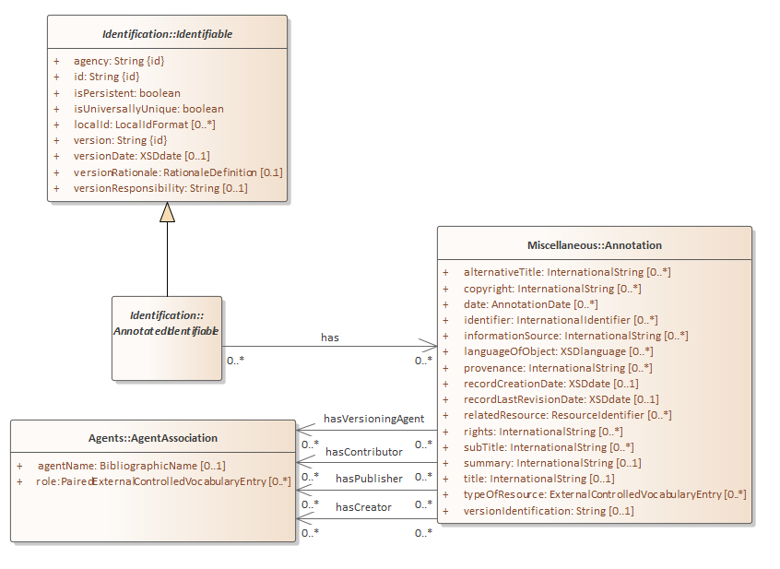
Discovery related information
Dublin Core related information
Title, date, rights, etc
Creator, contributor, publisher
and their roles
(e.g. CASRAI CRediT ontology)
Notes:
DDI-CDI carries forward the descriptive properties for elements that are found in earlier versions of DDI. These also map to Dublin Core and Schema.org.

Slide 38
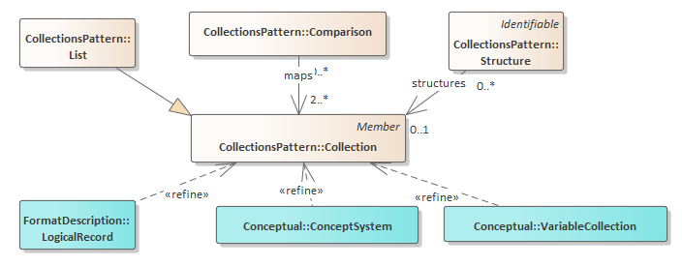
Collections
Lists
Networks
Used for:
ConceptSystem
VariableCollection
LogicalRecord
Notes:
CDI-CDI has an underlying pattern for Collections of things that ensures consistency in descriptions of things like lists of DataPoints in a record segment, or networks of steps in a parallelized procedure.

Slide 39
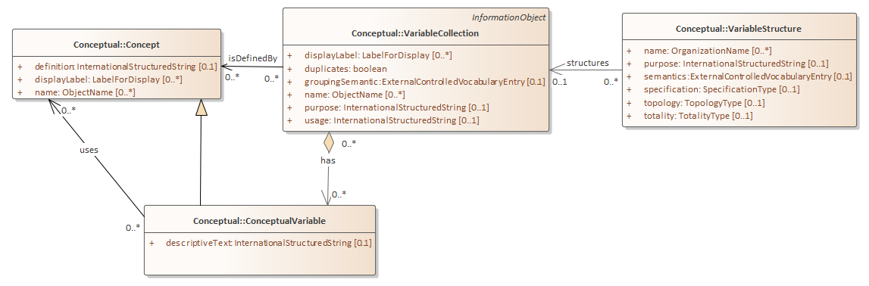
VariableCollections
Notes:
One example of a collection in DDI-CDI would be the VariableCollection. The graph at the bottom here is a network diagram of the relationships among four of the ConceptualVariables in our example. Systolic and diastolic are in a VariableCollection together and weight and pulse have conceptual relationships to that collection. This is the kind of structure that can be described for a collection of variables. Since RepresentedVariable and InstanceVariable extend ConceptualVariable, similar structures may be described for them, or even among all three types of variables in the cascade.
The same kind of structure can be described for Concepts and LogicalRecords.

Slide 40
Questions?
General questions from the chat.
Are there data structures that you commonly use that we don’t seem to have covered?
What are they?
Do you see potential in DDI-CDI for needs that you currently don’t have met?
What have we missed?

