Slide 1
An Introduction to DDI - CDI
Background for Public Reviewers
Webinar, 23 July 2020
DDI Modeling, Representation and Testing Working Group
(with thanks to the CODATA Decadal Programme)

Slide 2
DDI-CDI and the DDI Alliance
The Data Documentation Initiative (DDI) is a membership-based alliance of data archives, data libraries, research institutions, and government agencies
They have produced a series of technical specifications for data, metadata, and data management purposes
  DDI – Codebook
  DDI – Lifecycle
DDI – Cross-Domain Integration is an additional specification, designed to support new features
  As a stand-alone specification
  In combination with other technical specifications/models

Slide 3

TO REVIEW DDI-CDI!

Slide 4
Outline
Background: MRT and DDI 4 Core
Group and Events
DDI-CDI within the DDI Product Suite
DDI-CDI Features
DDI-CDI Alignment with Other Standards
Implementations of DDI-CDI
Current Status: The Public Review

Slide 5
History: MRT and DDI Developments
European DDI User Group Meeting (EDDI-2018, Berlin)
  Special DDI Moving Forward meeting – agreement to …
    Release “core” of the next-generation/model based DDI work
    A 1-year timeframe was proposed
Modelling, Representation, and Testing (MRT) group
  formed in early 2019
The working process was to base models on implementations, tested against real-world use cases
  ALPHA Network
  DDI R Libraries
  BLS time series model
  Others

Slide 6
Group and Events
MRT – small (9 members); meets at least weekly
No turnover; going over a year
Extremely focused and disciplined
Ottawa Sprint in week prior to NADDI 2019
Dagstuhl Sprint in October 2019
Public Review Release April 2020
Emphasize communications within DDI Alliance
  Management Technical committee
  Marketing Training

Slide 7
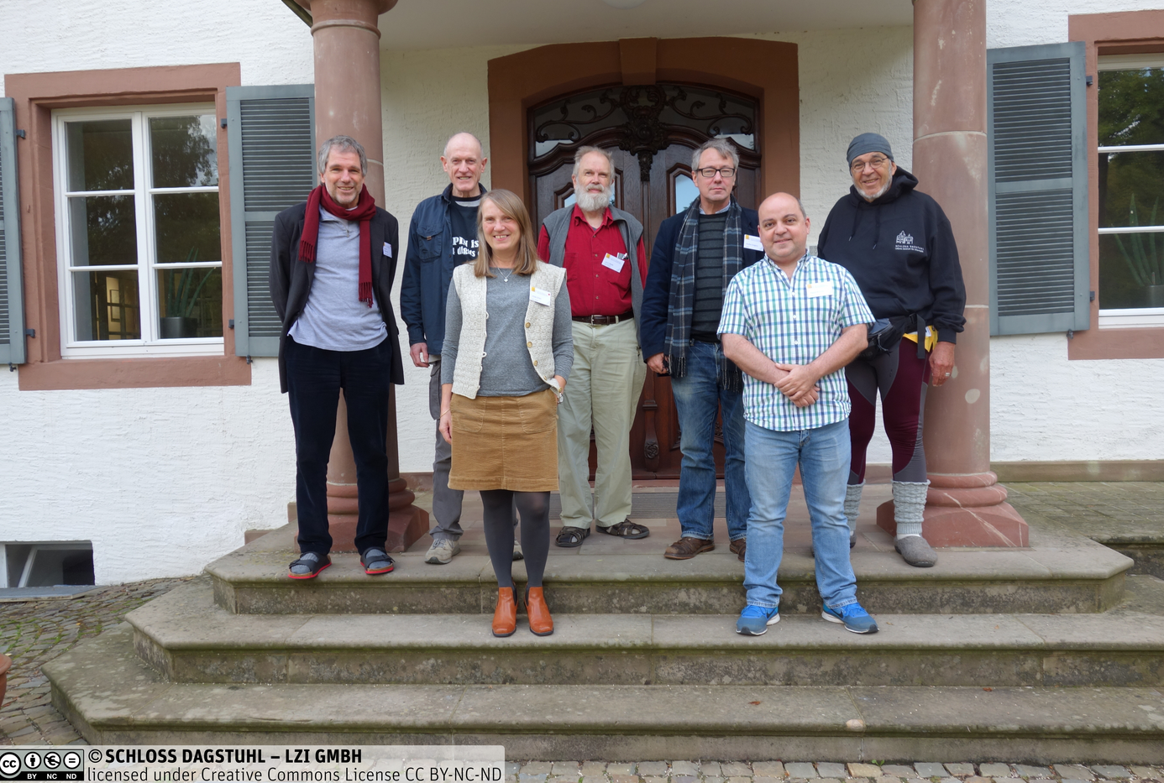
MRT Members
Back row, from left: Joachim Wackerow Dan Gillman
Larry Hoyle
Arofan Gregory
Jay Greenfield
Front row, from left: Hilde Orten
Flavio Rizzolo
Not in picture:
Oliver Hopt
Wendy Thomas
https://ddi-alliance.atlassian.net/wiki/spaces/DDI4/pages/707624961/Dagstuhl+Sprint+October+2019
Notes:
Back row, from left: Joachim Wackerow, Dan Gillman, Larry Hoyle, Arofan Gregory, Jay Greenfield
In front, from left: Hilde Orten, Flavio Rizzolo
Not on the picture: Oliver Hopt, Wendy Thomas

Slide 8
Evolution in Purpose
DDI-CDI was expected to be the “core” of a model-driven DDI
  A “next generation” after DDI-Lifecycle
Implementation cases showed that something else was needed: a focus on data provenance and data integration
DDI-CDI has emerged as a companion to DDI-Codebook and DDI-Lifecycle, not a replacement for them
The Social, Behavioral, and Economic (SBE) community needs better data integration tools
  So do other domains!

Slide 9
Real-World Trends and Requirements
Several changes have taken place in recent years which impact the requirements for DDI-CDI
  Larger research projects using data sometimes coming from external domains
  More data, coming from a wider range of sources
  Increased ability to compute with data (Machine Learning, etc.)
These changes result in requirements for data/metadata management
  More complete, machine-actionable metadata is needed
  Improved “context” for data is needed (provenance, semantics)
  New data formats/structures must be described and integrated
  A broader range of technology platforms require support (cloud, virtualization, analytics, AI, Internet of Things, etc.)

Slide 10
The World of Statistical Production
Generic Statistical Business Process Model (GSBPM)
  conceptual model; describes business processes for production
Generic Statistical Information Model (GSIM)
  conceptual model; describes information objects
  describe GSBPM sub-processes – inputs / outputs
  The GSBPM-GSIM task team is currently exploring the synergy between both models
GSIM and GSBPM are not enough to describe the data and how they flow thru statistical production. We need more granularity on a number of fronts:
  Provenance and lineage (Processes)
  Data description (Structures)
  Foundational metadata (Semantics)
Enter DDI-CDI…

Slide 11
DDI-CDI within the Product Suite
DDI-CDI does not replace DDI-C or DDI-L
  It can and will be used in combination with other DDI specifications
Adds support for describing new types of data
Expands the ability to describe process/provenance
Provides a detailed description of integration between disparate types of data
Extends the applicability of the DDI to new domains/disciplines
  As an integration tool
  As a data management tool
Captures conceptual aspects of activities and their resulting data, e.g. variables, classifications, concepts.

Slide 12
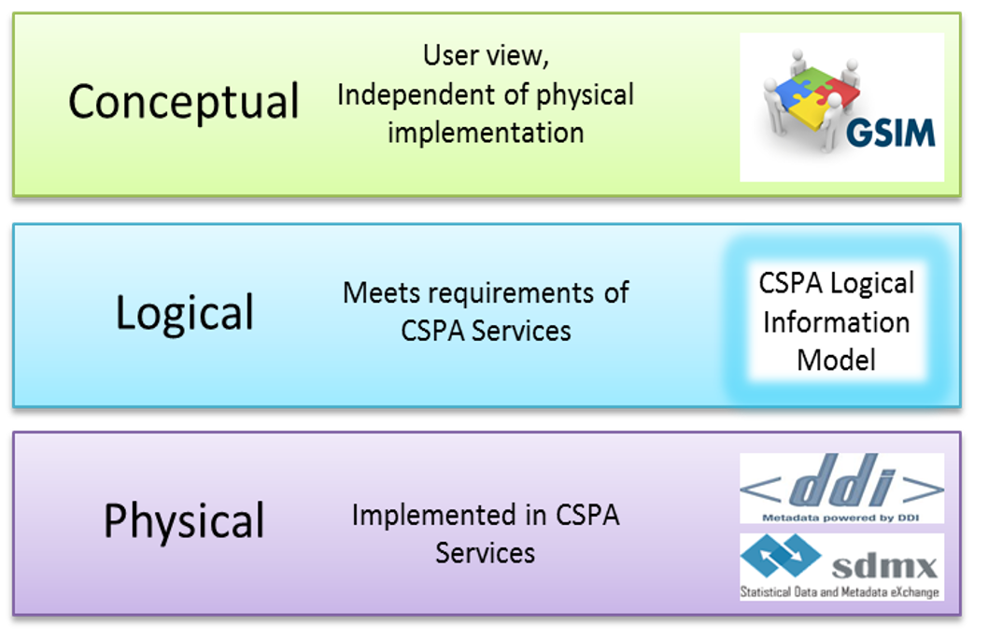
DDI-CDI, interoperability and CSPA
Interoperability is about the exchange of standardized entities with well-defined structure and semantics.
DDI-CDI enables interoperability within and across domains.
In the official statistics domain, interoperability is supported by the Common Statistical Production Architecture (CSPA). CSPA in turn necessitates a Logical Information Model…

Slide 13
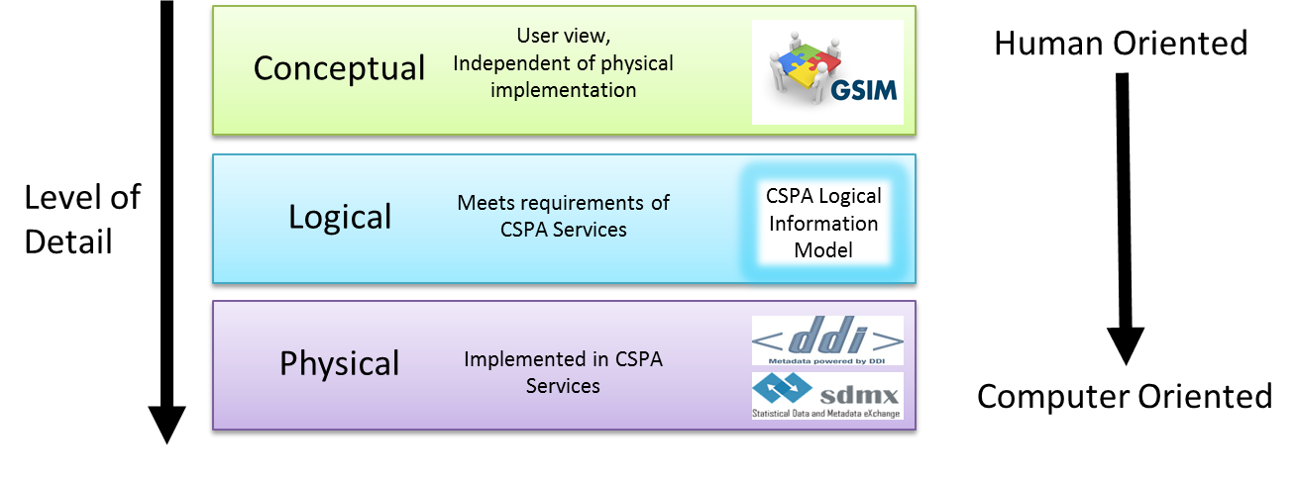
DDI-CDI and LIM
The Logical Information Model (LIM) was developed to bridge the gap between the conceptual nature of GSIM and the practical implementation focus of CSPA.
DDI-CDI can play the role of LIM by providing a logical model in UML and multiple machine-actionable syntax representations including XML, RDF, and JSON-LD to implement data description and processing solutions and services.
DDI-CDI

Slide 14
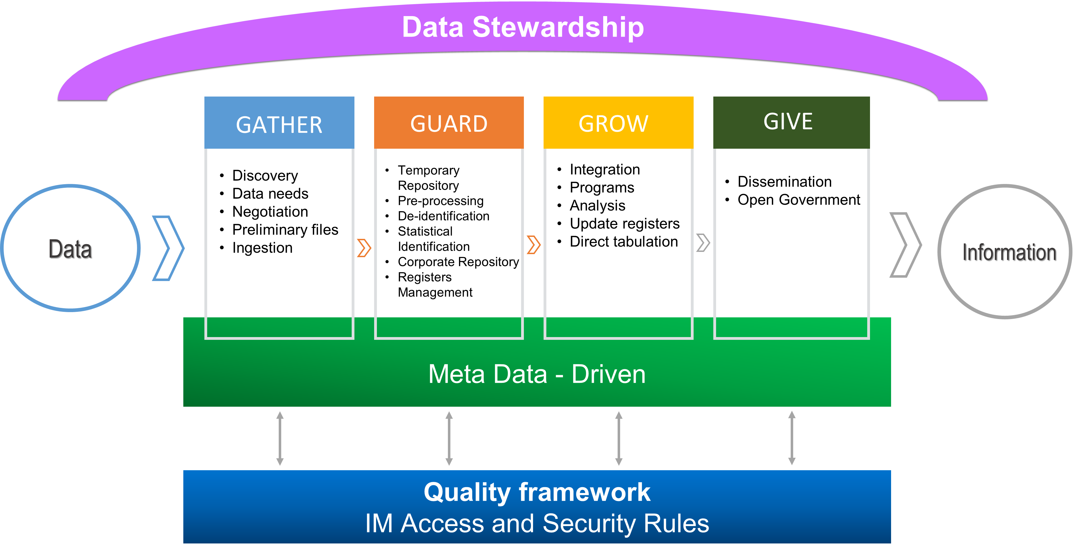
DDI-CDI and Data Production
DDI-CDI can help describing data in terms of the processes that transform it, the structures that organize them, and the concepts that explain it.
DDI-CDI is especially useful for describing data as it comes into the NSOs from a variety of source, gets pre-processed and then integrated for downstream consumption.
DDI-CDI

Slide 15
DDI-CDI and NSOs Use Cases
NSOs need to find, acquire, and integrate data from both traditional and new sources at an ever increasing pace, while taking care of security and quality of outputs.
Data cycles are increasingly faster and Machine Learning continues to drive the need for ever increasing amounts of data.
Consequently, NSOs need new ways of describing data and the processes that produce them.
DDI-CDI can not only describe traditional well-structured data, but also data that is less structured/described at the time of capture and that becomes more structured/described as it’s processed and integrated.
DDI-CDI accomplishes this by providing descriptive support for 1) less structured data like the key/value store, 2) metadata infusion by way of its foundational variable cascade and 3) data transformations by way of DDI-CDI process model

Slide 16
DDI-CDI and Admin Data Processing
Admin data files are initially stored in a data lake, go thru some basic validation and cleansing, and then are persisted with some preliminary schema information in a more structured environment for further processing.
This schema information changes with each processing step as data is better understood and organized according to the processing/analysis at hand.
The persisted data is then integrated with information from statistical registers. This could involve record linkage with relevant datasets.
After that, the resulting data is de-identified and persisted in a data hub for consumption downstream.
The process above can also include some preliminary data science step.
This whole workflow and the data involved can be described in detail with the DDI-CDI process model and the data description model, respectively.

Slide 17
DDI-CDI Basic Data Structure Types
Data Description centered on Datums (atomic pieces of data), organized by Data Structure Components (variables in a data structure), and identified by Keys.
Wide Data
  Traditional rectangular unit record data sets. Rows represent records for units; columns correspond to variables.
Long Data
  Each record has a unit identifier, variable identifier, value attributes, and value. There usually are multiple records for any given unit. The structure is used, for example, in event data and data warehouses.
Key-Value Data
  An identifier paired with a value (“big data”). For example, the key is a unit ID (Dan Gillman) and variable ID (gender) combination whose value is ‘M’ for male.
Multi-Dimensional Data
  Data which represent the combinations of one category from each of several category sets – the dimensions. Examples are multi-dimensional cubes and time series.

Slide 18
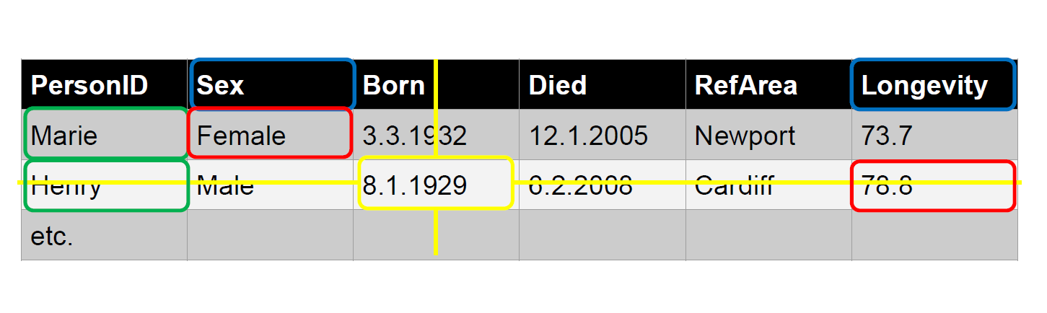
Data Example - Wide
Notes:
A Unit record data table is a common way to organize data.
This structure is also referred to as a rectangular data file.
A cell in the Unit record table is an intersection between a column representing a variable and a row representing a measurement unit.
Each cell of the table contains an instanceValue.
The objects of the Wide format Unit record data table are UnitDataRecords, Variables and InstanceValues.
In the Wide format the rows correspond to each unit record, which is a set of InstanceValues for one entity.
The columns correspond to each variable measure or categorization. Cell entries are InstanceValues.
In the figure ‘Marie’ and ‘Henry’ are identifiers for each of the records.
‘Sex’, ‘Longevity’ etc. are variables and ‘Female’ and ’73,7’ are example of InstanceValues.

Slide 19
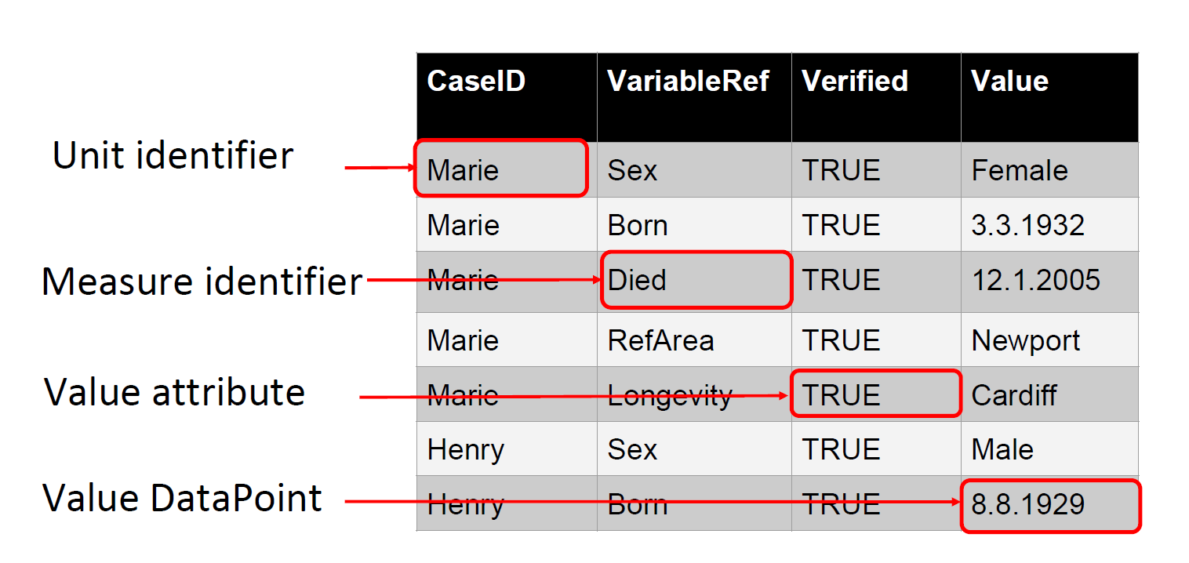
Data Example - Long
Notes:
The same data as in the wide example can be expressed in a different format called Long as shown in the figure
This format is often used to express event data.
In the Long format each row now contains a Unit Identifier, a Mesure identifier, a value Attribute and a value DataPoint.
In pure form, each row of a long structure contains a DataPoint with the value of interest, along with identifiers for a Unit and a column with a code that identifies the variable that associates with the value in the value DataPoint.
In the figure the Value column contains DataPoints with values from more than one variable, Sex, Born, Died, RefArea, and Longevity. Note that there may be many rows for a Unit (like for “Marie”).
There can also be columns containing attribute values. The Verified column below is an attribute that indicates whether the value in the Value column has been verified.

Slide 20
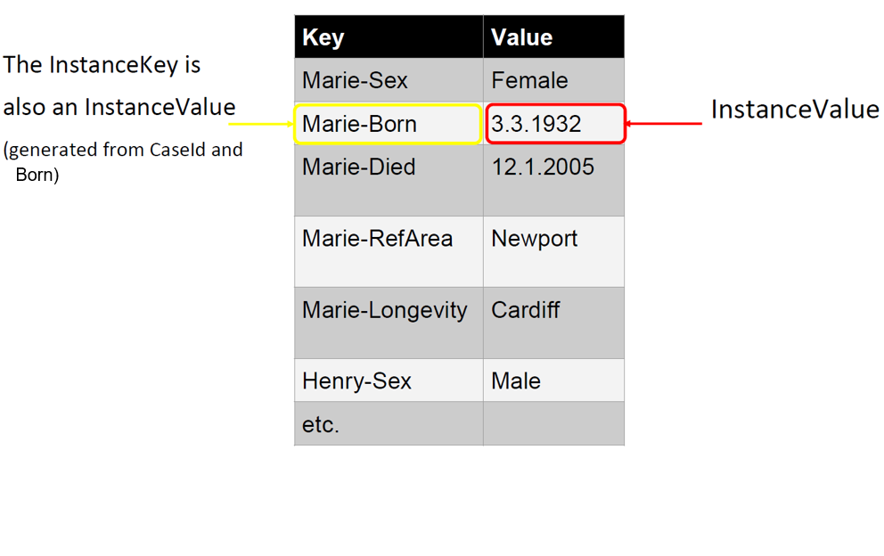
Data Example – Key-Value

Slide 21
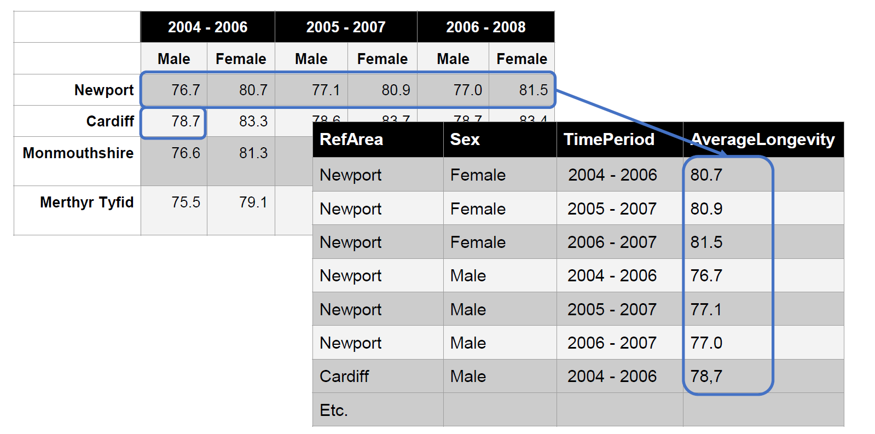
Data Example - Multidimensional and Long
Notes:
These data might be stored in a Long structure like this

Slide 22
DDI-CDI Process Descriptions
The DDI-CDI Process model can be used in statistical production in a number of ways:
  To function as an extension of both GSBPM and the GSIM Business group by providing both higher-level, human-readable business process documentation and machine-actionable syntaxes;
  To describe complex statistical production processes, e.g. record linkage, admin data pre-processing, system of national accounts, at any desired granularity;
  To design reusable, parameterized steps that can include machine-actionable information flows.
It can also map to:
  Common syntaxes used in statistical production for data transformations, cleaning, analyses, etc. e.g.: R, SAS, Stata, Python, SPSS
  Other standard transformation models e.g.: Structured Data Transform Language (SDTL), Validation and Transformation Language (VTL).

Slide 23
DDI-CDI, GSBPM and GSIM
DDI-CDI can also provide a level of detail that GSBPM and GSIM lack by documenting subprocesses/process steps with:
  various control flow types, e.g. adaptive sample design;
  two processing styles, i.e. deterministic (static flows specified in advanced with control constructs) or non-deterministic (dynamic flows adapting to external conditions with rulesets, temporal logic and/or parallel processing);
  information flows across process steps, e.g. linking output parameters of one step with input parameters of another;
  lifecycle management, e.g. how information objects are versioned and managed;
  mappings to other standards, e.g. PROV/ProvONE, Business Process Model and Notation (BPMN), Decision Model and Notation (DMN), Common Workflow Language (CWL).

Slide 24
DDI-CDI Foundational Metadata
Core elements to be modelled – based on DDI 4 work
Statistical concepts and their various usages
Includes categories and variables and much more
DDI-CDI tries to adapt common terms – incorporate domain semantics
Important feature: The variable cascade
  How different types of variables relate to each other
  How they describe data creation, processing and use

Slide 25
Comparability among variables
Conceptual variable
Common variable specification without a representation
maritalstatus
(conceptual variable)
maritalstatus
(represented variable)
maritalstatusplus
(represented variable)
Represented variable
Common variable specification with a code representation
maritalstatus
(variable)
maritalstatus2010
(variable)
maritalstatus
2018
(variable)
Variable
Variable specification within a dataset context
Notes:
What is variable cascade?
Three Different (distinct) sets of data with a different variables all measuring marriage status.
Represented variables link variables which are directly comparable.
Same representation of the value domain. It doesn’t care about the question asked- only the value domain.
The represented variable is a way to measure marriage and so links to the marriage conceptual variable.
Represented variable means that they are not directly comparable but can be made to be comparable.
The third dataset has a different code list (i.e. value domain) and so it needs a new representative variable which then links to the conceptual variable.
Concept variable defines a measure without defining the measurement.
Value domain = Variable representation in DDI

Slide 26
Current Status/Timeline
Public review period ongoing through July 2020
Series of webinars to recruit meaningful review from other domains
  CODATA is supporting this activity
Revised review version released in September 2020
Focused review at intensive Dagstuhl workshop or virtual equivalent
  CODATA has offered to convene a working group of reviewers from external domains to feed requirements into MRT
First production release early 2021

Slide 27
Review by “External” Domains
We will be conducting webinars among several domains to recruit reviewers from outside the traditional DDI community:
Health/Infectious Disease
Earth sciences
Life Sciences
Engineering
Physical sciences
Sustainable Development Goals (SDGs) and other policy monitoring indicators

Slide 28
Further Discussions
Groups will be convened to discuss the following topics in follow-up meetings:
Data Description related content
Transformation between data structures
The Variable Cascade for comparison and harmonization purposes
Process/provenance
Model related topics – UML/XMI
Relationship between DDI-CDI and other standards
Please get back to us if you would be interested to discuss these topics with us, or if you have further ideas.

Slide 29
Welcome to the DDI-CDI review page
at https://ddi-alliance.atlassian.net/wiki/x/IQBPMw

Slide 30
First Things First…
The Intro document (for a brief summary):
https://ddi-alliance.atlassian.net/wiki/download/attachments/860815393/Part_1_DDI-CDI_Intro_PR_1.pdf

Slide 31
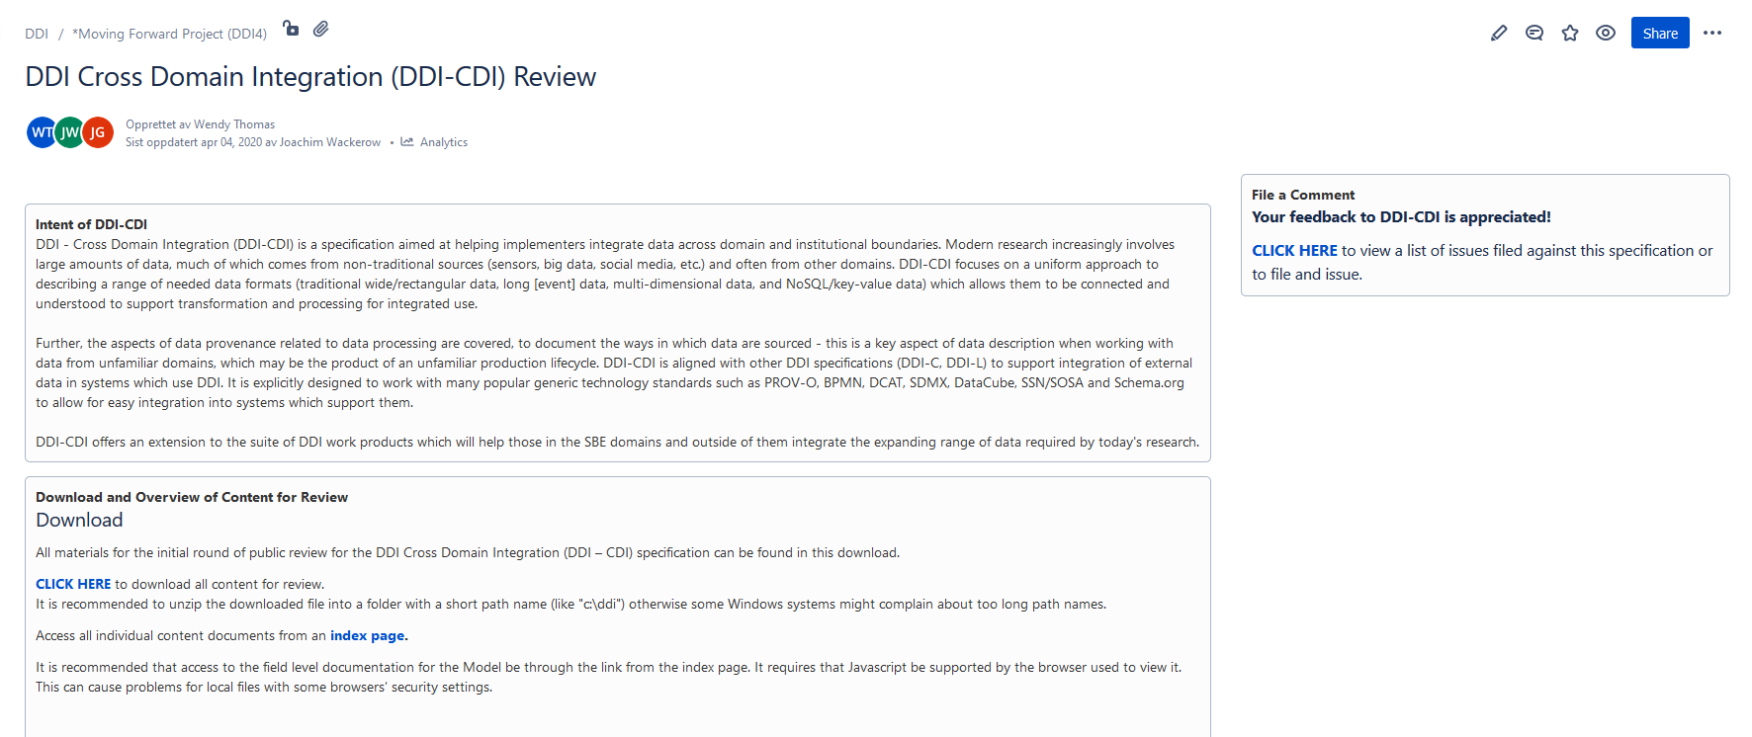
DDI-CDI Review page at https://ddi-alliance.atlassian.net/wiki/x/IQBPMw
Post comment
Download package
Access package content from index page

Slide 32
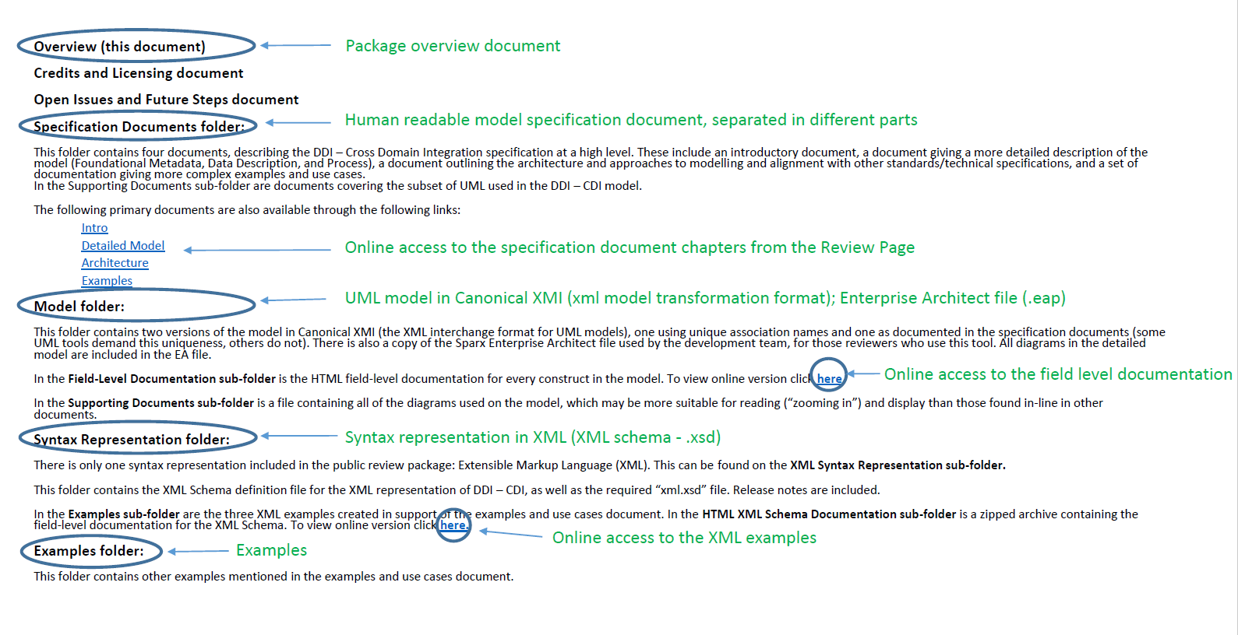
DDI-CDI Review page - Overview of Content

Slide 33
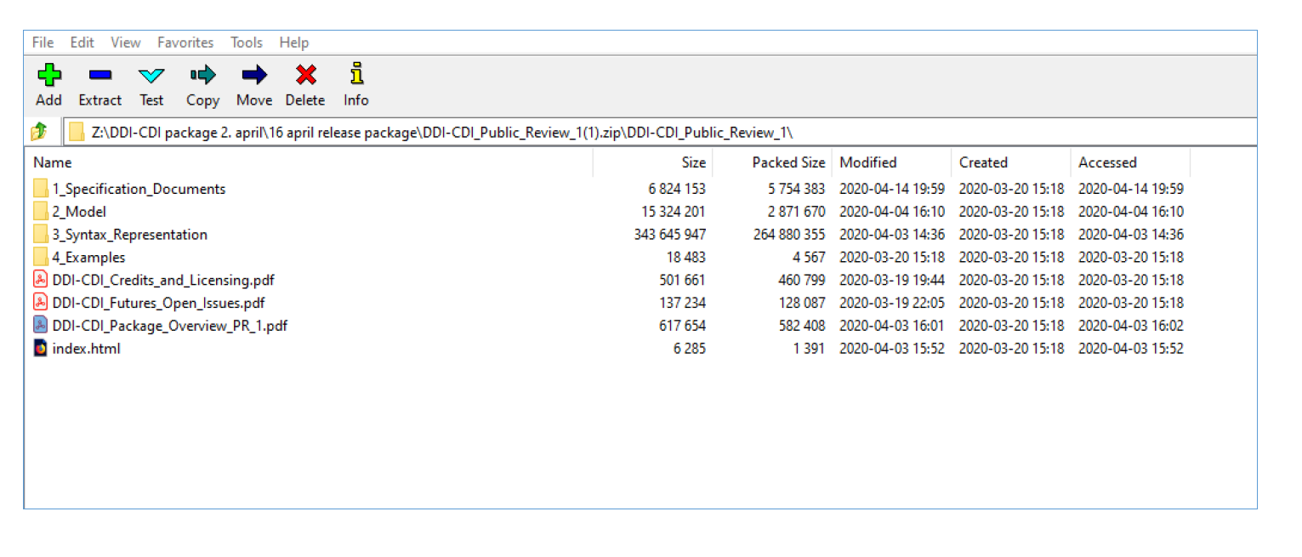
The DDI-CDI Review Package (when downloaded and unzipped)

Slide 34
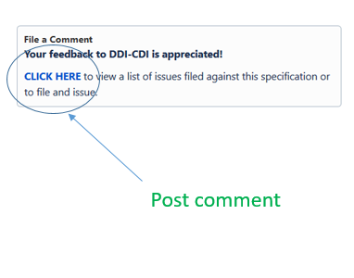
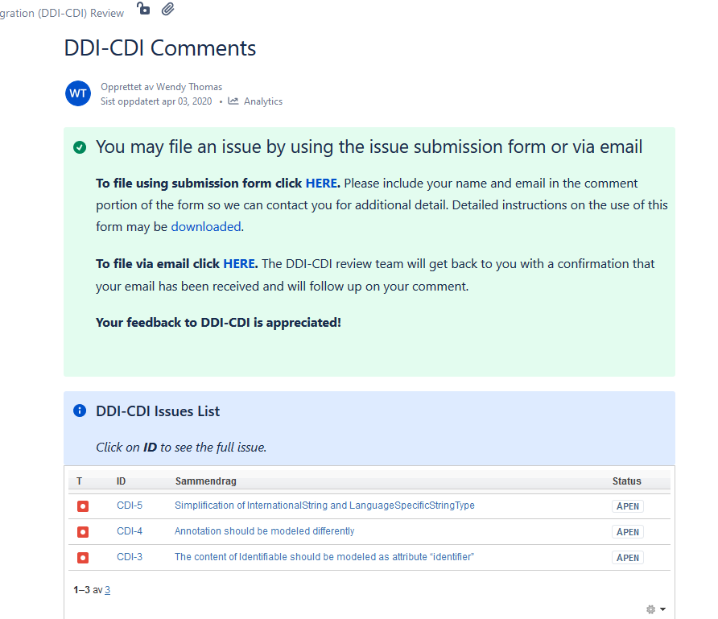
Comments Page (from Review Page): https://ddi-alliance.atlassian.net/wiki/spaces/DDI4/pages/897155138/DDI-CDI+Comments
Access to Jira issue tracker for DDI-CDI
Guidelines to filing an issue in Jira
File issues by e-mail
View filed issues

Slide 35
In-Depth Engagement…
If you are serious about review and implementation of DDI-CDI, you can also:
  Contact us and discuss your planned implementation
  Engage in detailed technical review with MRT members
  Implement the revised specification prior to release
Further detail on data description
  data description webinars https://bit.ly/DDI-CDI-data-description
  August 12 @ 1400 UTC

Slide 36
Your comments to the DDI-CDI are appreciated ☺
Review page: https://ddi-alliance.atlassian.net/wiki/x/IQBPMw
Contact: ddi-cdi@googlegroups.com joachim.wackerow@gesis.org

