Slide 1
An Introduction to DDI - CDI
Background for Public Reviewers
Webinar, 16 June 2020
DDI Modeling, Representation and Testing Working Group
(with thanks to the CODATA Decadal Programme)

Slide 2
DDI-CDI and the DDI Alliance
The Data Documentation Initiative (DDI) is a membership-based alliance of data archives, data producers, research institutions, and government agencies
They have produced a series of technical specifications for data, metadata, and data management purposes
DDI – Codebook
DDI - Lifecycle
DDI – Cross-Domain Integration is an additional specification, designed to support new features
As a stand-alone specification
In combination with other technical specifications/models

Slide 3
TO REVIEW DDI-CDI!

Slide 4
Outline
Background: MRT and DDI 4 Core
Group and Events
DDI-CDI within the DDI Product Suite
DDI-CDI Features
DDI-CDI Alignment with Other Standards
Implementations of DDI-CDI
Current Status: The Public Review

Slide 5
History: MRT and DDI Developments
In the margins of the 2018 European DDI User’s Group meeting (Berlin) it was agreed that a “core” of the next-generation/model based DDI work should be brought to market
A 1-year timeframe was proposed
The Modelling, Representation and Testing (MRT) group was formed in early 2019
The working process was to base models on implementations, tested against real-world use cases
ALPHA Network
DDI R Libraries
Others (BLS for time series, etc.)

Slide 6
Group and Events
Small group (9 members) meeting weekly (and more) for over a year
No turn-over – members have been extremely focused and disciplined
Ottawa Sprint in margins of NADDI 2019
Dagstuhl Sprint in October 2019
Public Review Release April 2020
Communications with management, technical committee work, marketing, and training groups within the DDI Alliance have been emphasized

Slide 7
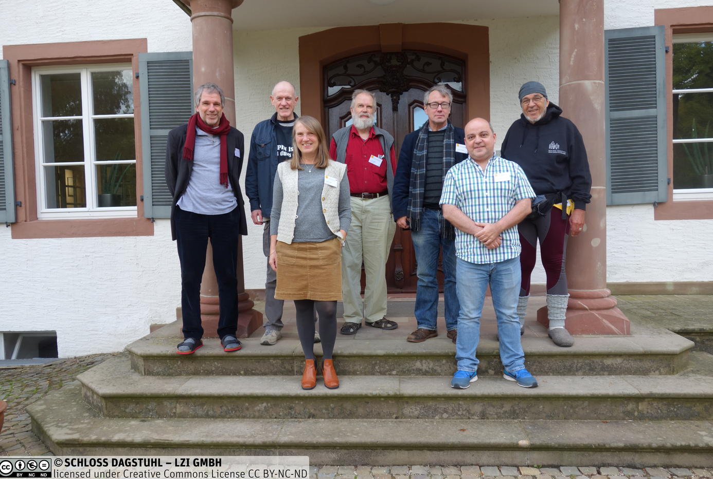
MRT Members
Arofan Gregory
Dan Gillman
Flavio Rizzolo
Hilde Orten
Jay Greenfield
Joachim Wackerow
Larry Hoyle
Oliver Hopt
Wendy Thomas
https://ddi-alliance.atlassian.net/wiki/spaces/DDI4/pages/707624961/Dagstuhl+Sprint+October+2019

Slide 8
Evolution in Purpose
DDI-CDI was expected to be the “core” of a model-driven DDI
A “next generation” after DDI-Lifecycle
Implementation cases showed that something else was needed: a focus on data provenance and data integration
DDI-CDI has emerged as a companion to DDI-Codebook and DDI-Lifecycle, not a replacement for them
The Social, Behavioral, and Economic (SBE) community needs better data integration tools
So do other domains!

Slide 9
Real-World Trends and Requirements
Several changes have taken place in recent years which impact the requirements for DDI-CDI
Larger research projects using data sometimes coming from external domains
More data, coming from a wider range of sources
Increased ability to compute with data (Machine Learning, etc.)
These changes result in requirements for data/metadata management
More complete, machine-actionable metadata is needed
Improved “context” for data is needed (provenance, semantics)
New data formats/structures must be described and integrated
A broader range of technology platforms require support

Slide 10
DDI-CDI within the Product Suite
DDI-CDI does not replace DDI-C or DDI-L
It can and will be used in combination with other DDI specifications
It adds support for describing new types of data
It expands the ability to describe process/provenance
It provides a detailed description of integration between disparate types of data
Extends the applicability of the DDI to new domains/disciplines
As an integration tool
As a data management tool

Slide 11
DDI-CDI Features: Data Description and Provenance
Provides an exact understanding of data in a variety of formats from many different sources.
Flexible means of describing data that can reveal the connection between the same data existing in different formats.
Means of describing the provenance of data at a detailed level.

Slide 12
DDI-CDI Goals and Purpose
Design goal: Create a useful, implementable product based on real use cases
Developed with modern systems in mind
That employs a variety of models
That complies with a range of specifications, related to data description and provenance
Fills in information that other standards do not capture (align rather than replace)
For data: Description of a single data point – a Datum – that can play different roles in different data structures and formats
For process/provenance: Packaging of machine level processes into a structure that relates to business processes described at a level understood by users.

Slide 13
DDI-CDI Domain-Independence
Designed to be used by any domain
Focus on structure and generic aspects of the things it describes
Generic elements like variables and classifications
Do not cover domain specific aspects like semantics or lifecycles (provided by domains)
Complementary to domain specific models, for example DDI-Lifecycle
Well suited to combining data from more than one domain or system (cross domain)

Slide 14
DDI-CDI Datum-Oriented Data Description
Based on atomic components – individual Datums
Datums can play different roles in different formatting of the same (or different) dataset(s), depending on how it has been transformed or processed (Identifier, Descriptor, Measure, etc.)
Each Datum’s use can be described across a series of processes as it plays different roles in different structures

Slide 15
DDI-CDI Basic Data Structure Types
Wide Data
Traditional rectangular unit record data sets. Each record has a unit identifier and a set of measures for the same unit
Long Data
Each record has a unit identifier and a set of measures but there may be multiple records for any given unit. The structure is used for many different data types, for example event data
Multi-Dimensional Data
Data in which observations are identified using a set of dimensions. Examples are multi-dimensional cubes and time series
Key-Value Data
Set of measures, each paired with an identifier (“big data”)

Slide 16
Data Example - Wide
Notes:
A Unit record data table is a common way to organize data.
This structure is also referred to as a rectangular data file.
A cell in the Unit record table is an intersection between a column representing a variable and a row representing a measurement unit.
Each cell of the table contains an instanceValue.
The objects of the Wide format Unit record data table are UnitDataRecords, Variables and InstanceValues.
In the Wide format the rows correspond to each unit record, which is a set of InstanceValues for one entity.
The columns correspond to each variable measure or categorization. Cell entries are InstanceValues.
In the figure ‘Marie’ and ‘Henry’ are identifiers for each of the records.
‘Sex’, ‘Longevity’ etc. are variables and ‘Female’ and ’73,7’ are example of InstanceValues.

Slide 17
Data Example - Long
Notes:
The same data as in the wide example can be expressed in a different format called Long as shown in the figure
This format is often used to express event data.
In the Long format each row now contains a Unit Identifier, a Mesure identifier, a value Attribute and a value DataPoint.
In pure form, each row of a long structure contains a DataPoint with the value of interest, along with identifiers for a Unit and a column with a code that identifies the variable that associates with the value in the value DataPoint.
In the figure the Value column contains DataPoints with values from more than one variable, Sex, Born, Died, RefArea, and Longevity. Note that there may be many rows for a Unit (like for “Marie”).
There can also be columns containing attribute values. The Verified column below is an attribute that indicates whether the value in the Value column has been verified.

Slide 18
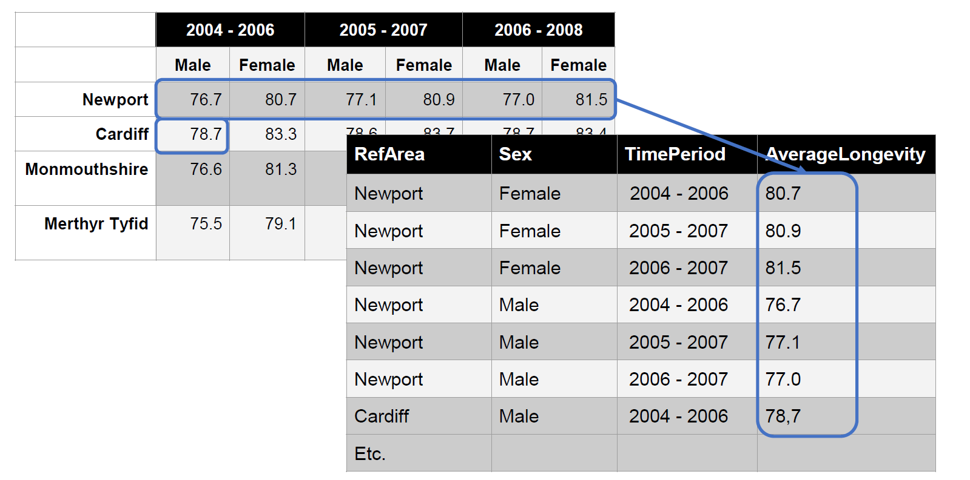
Data Example - Multidimensional and Long
Notes:
These data might be stored in a Long structure like this

Slide 19
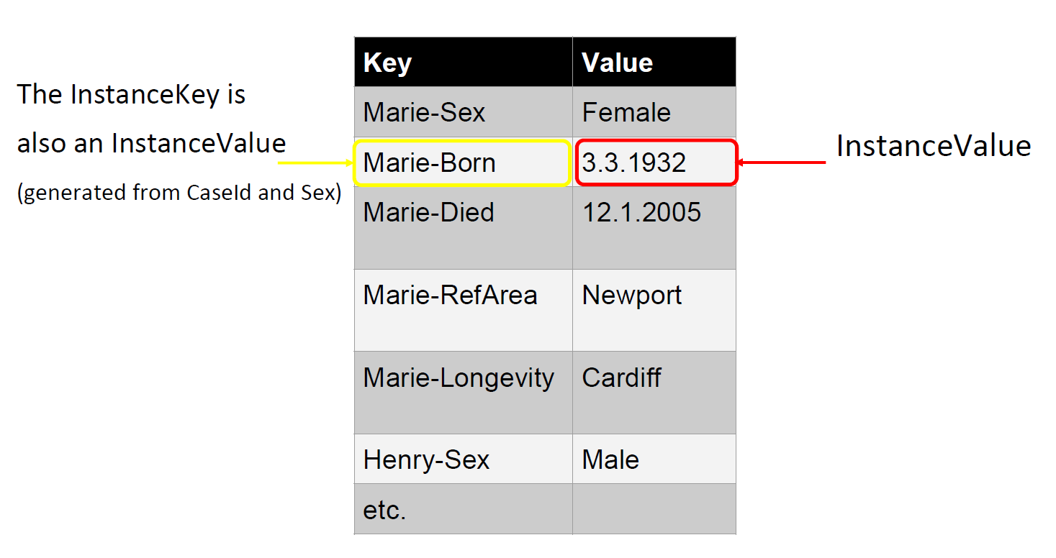
Data Example - Key-Value
Born)
Notes:
In this example the data are stored as key-value pairs. The Key column contains KeyMember values that identify the associated InstanceValue. The date 3.3.1932, for example is described by the KeyMember “Marie-Born”. The is key identifies both the Unit (Marie) and the variable (Born). The cell containing 3.3.1932 is the DataPoint identified by the Key.
The KeyValue structure can be used for data in lake, hadoop data/big data

Slide 20
DDI-CDI Provenance and Process
To understand data we need to understand how it was processed and transformed
Popular models to describe this e.g.: BPMN (Business Process Modelling and Notation), PROV Ontology (W3C)
Syntaxes for deriving transformations, cleaning, analyses etc., e.g.: R, SAS, Stata, Python, SPSS.
Standard transformation models e.g.: Structured Data Transform Language (SDTL), Validation and Transformation Language (VTL)
DDI-CDI tries to do something that compliments such models:
Connecting specific machine interpretable processes (syntax specific) with higher-level human readable business process documentation
Supports both linear (flow specified in advance) and declarative processing (the system rather than the developer controls when computations are processed)

Slide 21
DDI-CDI Foundational Metadata
Core elements to be modelled – based on DDI 4 work
Statistical concepts and their various usages
Includes categories and variables and much more
DDI-CDI tries to adapt common terms – incorporate domain semantics
Important feature: The variable cascade
How different types of variables relate to each other
How they describe data creation, processing and use

Slide 22
Documenting comparability among variables
Conceptual variable Common variable specification without a representation
maritalstatus (conceptual variable)
maritalstatus (represented variable)
maritalstatusplus (represented variable)
Represented variable
Common variable specification with a code representation
maritalstatus (variable)
maritalstatus2010 (variable)
maritalstatus
2018 (variable)
Variable
Variable specification within a dataset context
Notes:
What is variable cascade?
Three Different (distinct) sets of data with a different variables all measuring marriage status.
Represented variables link variables which are directly comparable.
Same representation of the value domain. It doesn’t care about the question asked- only the value domain.
The represented variable is a way to measure marriage and so links to the marriage conceptual variable.
Represented variable means that they are not directly comparable but can be made to be comparable.
The third dataset has a different code list (i.e. value domain) and so it needs a new representative variable which then links to the conceptual variable.
Concept variable defines a measure without defining the measurement.
Value domain = Variable representation in DDI

Slide 23
DDI-CDI Interoperability, Sustainability, and Standards Alignment
DDI-CDI is a model intended to be implemented across a wide variety of technology platforms
In combination with other models and standards, models and specifications
Formalized in UML (Unified Modelling Language) – designed to be “future-proof”
Provided in the form of Canonical XMI – interchange format of UML supported by many different UML tools
Platform independent model, makes it more easily applicable across a broad range of applications
XML Schema syntax representation is provided – RDF syntax representation now being ivestigated
Builds on and aligns with other (defined) standards where appropriate (refined, extended, or used)

Slide 24
DDI-CDI Implementations
To describe new kinds of data (sensors, registers, clinical records, social media, etc.) and their provenance
To integrate new data with existing data
For analysis
For management
Support search and harmonization across collections of different data types
Variable cascade
Integrate data across domain boundaries at a detailed level (SSHOC)

Slide 25
Current Status/Timeline
Public review period ongoing through July 2020
Series of webinars to recruit meaningful review from other domains
CODATA is supporting this activity
Revised review version released in September 2020
Focused review at intensive Dagstughl workshop or virtual equivalent
CODATA has offered to convene a working group of reviewers from external domains to feed requirements into MRT
First production release early 2021

Slide 26
Review by “External” Domains
We will be conducting webinars among several domains to recruit reviewers from outside the traditional DDI community:
Health/Infectious Disease
Earth sciences
Life Sciences
Engineering
Physical sciences
Sustainable Development Goals (SDGs) and other policy monitoring indicators

Slide 27
Further Discussions
Groups will be convened to discuss the following topics in follow-up meetings:
Data Description related content
Transformation between data structures
The Variable Cascade for comparison and harmonization purposes
Process/provenance
Model related topics – UML/XMI
Relationship between DDI-CDI and other standards
Please get back to us if you would be interested to discuss these topics with us, or if you have further ideas.

Slide 28
Welcome to the DDI-CDI review page
at https://ddi-alliance.atlassian.net/wiki/x/IQBPMw

Slide 29
First Things First…
The Intro document (for a brief summary):
https://ddi-alliance.atlassian.net/wiki/download/attachments/860815393/Part_1_DDI-CDI_Intro_PR_1.pdf

Slide 30
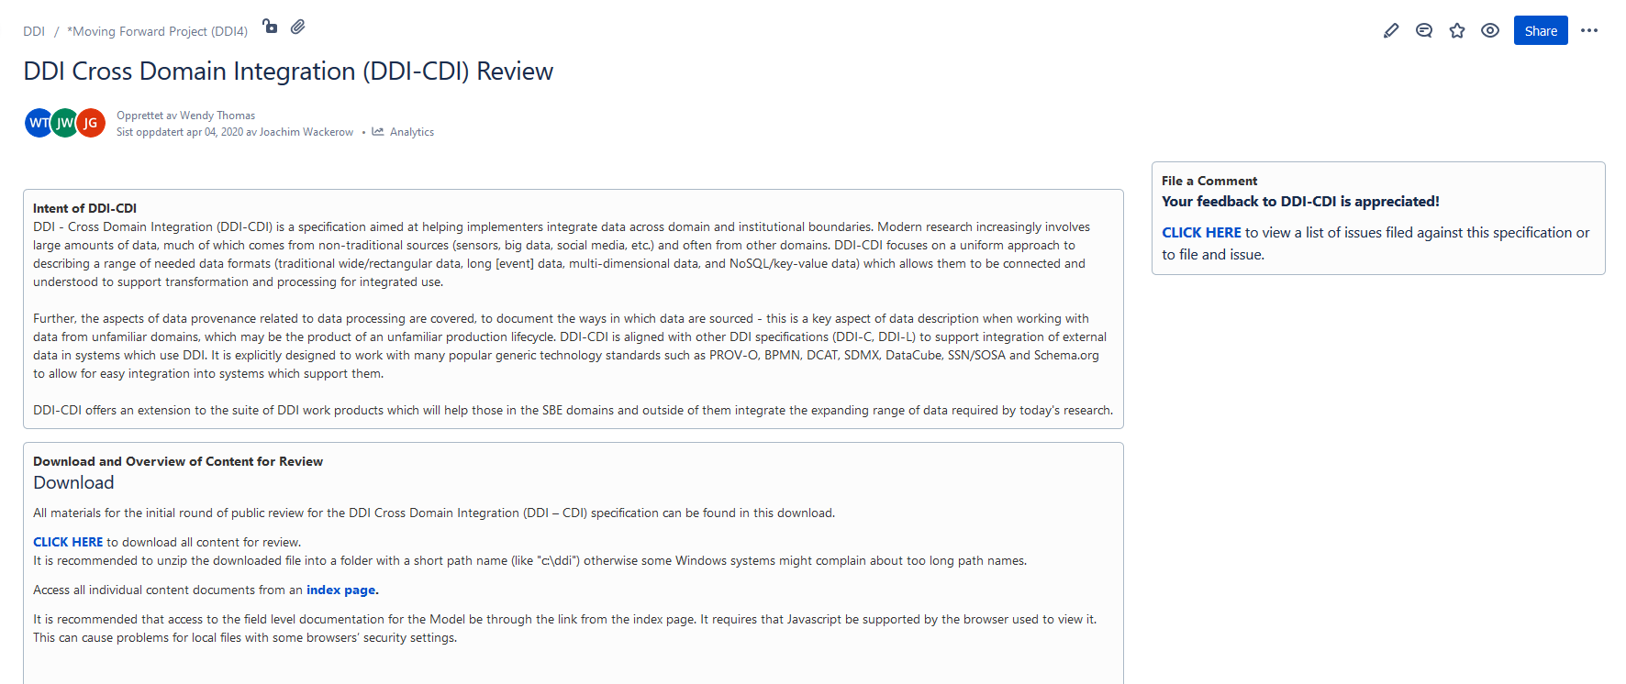
DDI-CDI Review page at https://ddi-alliance.atlassian.net/wiki/x/IQBPMw
Post comment
Download package
Access package content from index page

Slide 31
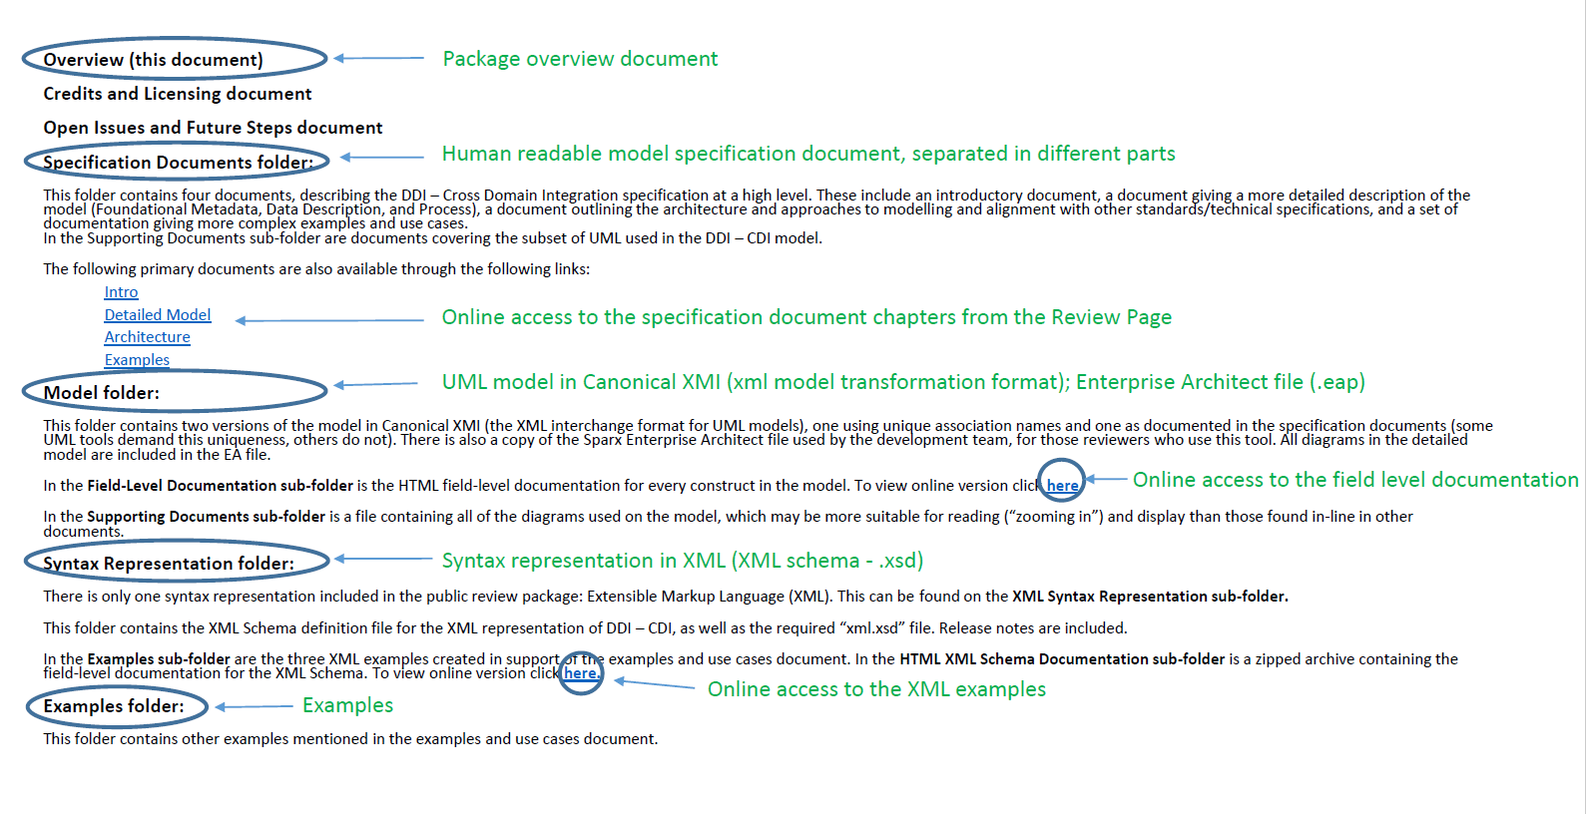
DDI-CDI Review page - Overview of Content

Slide 32
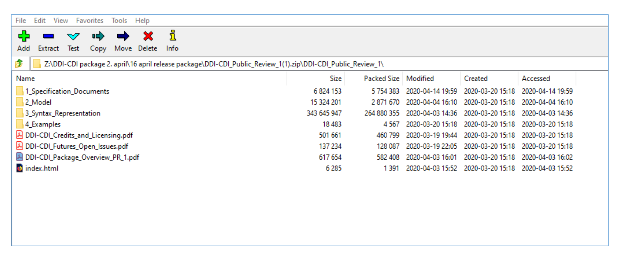
The DDI-CDI Review Package (when downloaded and unzipped)

Slide 33
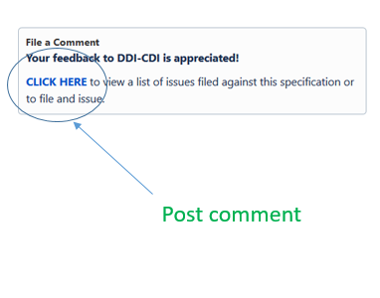
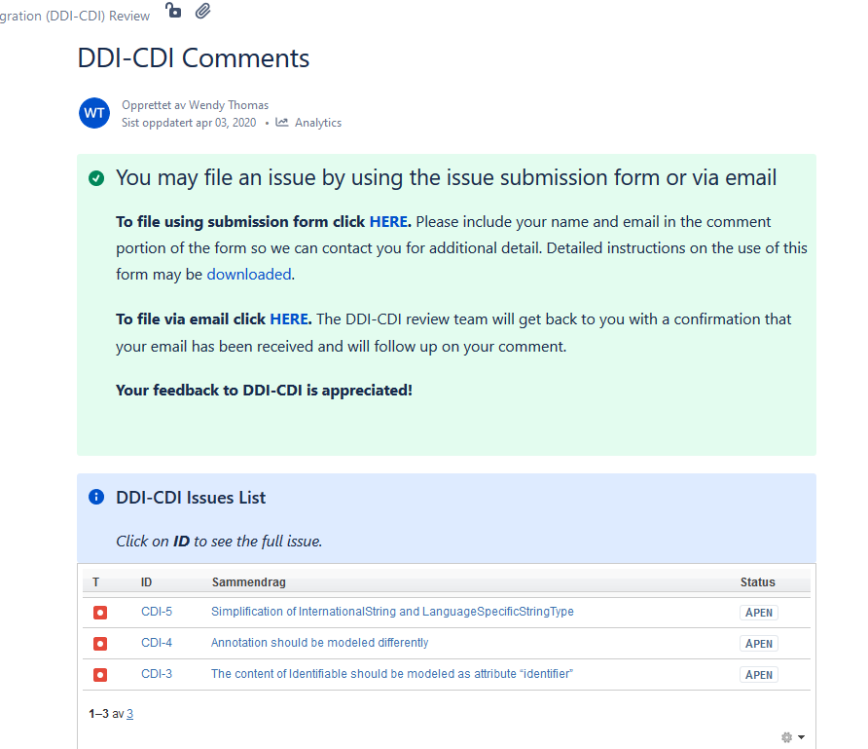
Comments Page (from Review Page): https://ddi-alliance.atlassian.net/wiki/spaces/DDI4/pages/897155138/DDI-CDI+Comments
Access to Jira issue tracker for DDI-CDI
Guidelines to filing an issue in Jira
File issues by e-mail
View filed issues

Slide 34
In-Depth Engagement…
If you are serious about review and implementation of DDI-CDI, you can also:
Contact us and discuss your planned implementation
Engage in detailed technical review with MRT members
Implement the revised specification prior to release

Slide 35
Your comments to the DDI-CDI are appreciated ☺ Review page: https://ddi-alliance.atlassian.net/wiki/x/IQBPMw Contact: ddi-cdi@googlegroups.com joachim.wackerow@gesis.org

